Slide 1
Year 5
Welcome to Meet the Teacher
September 2023

Slide 2
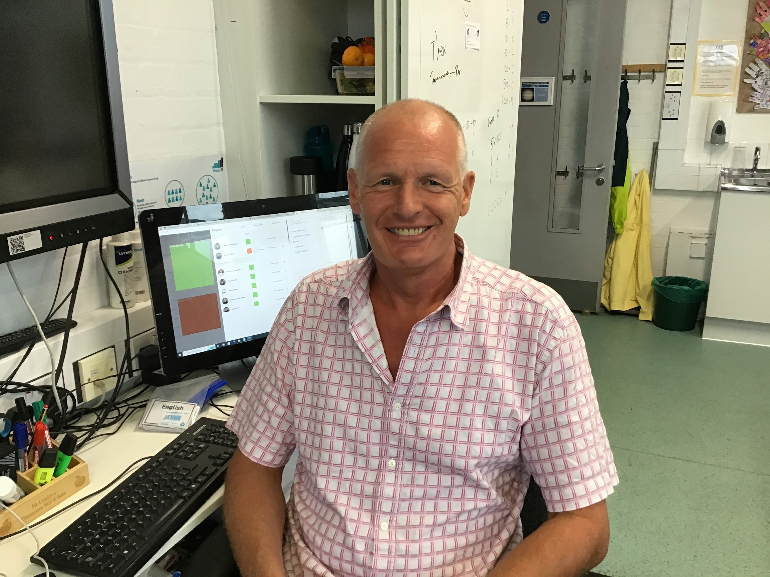
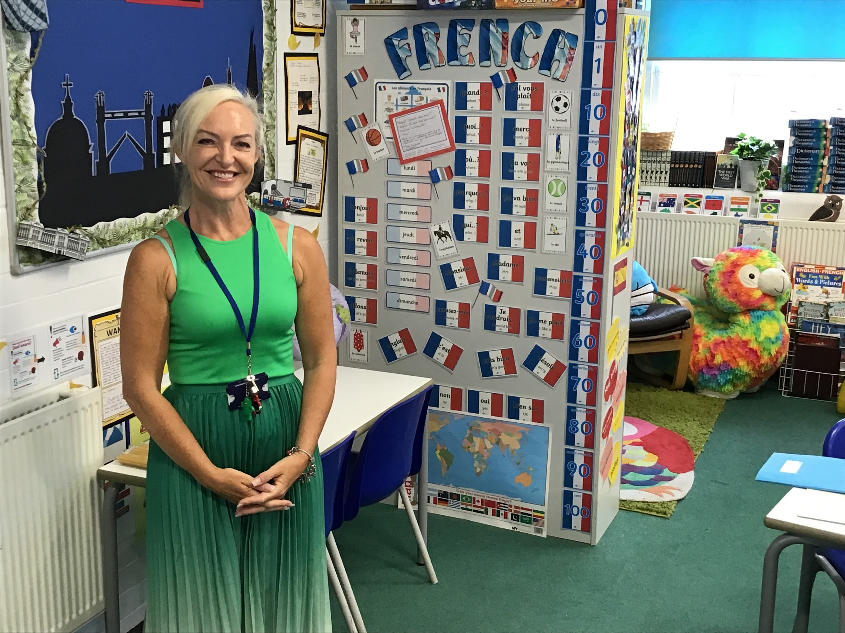
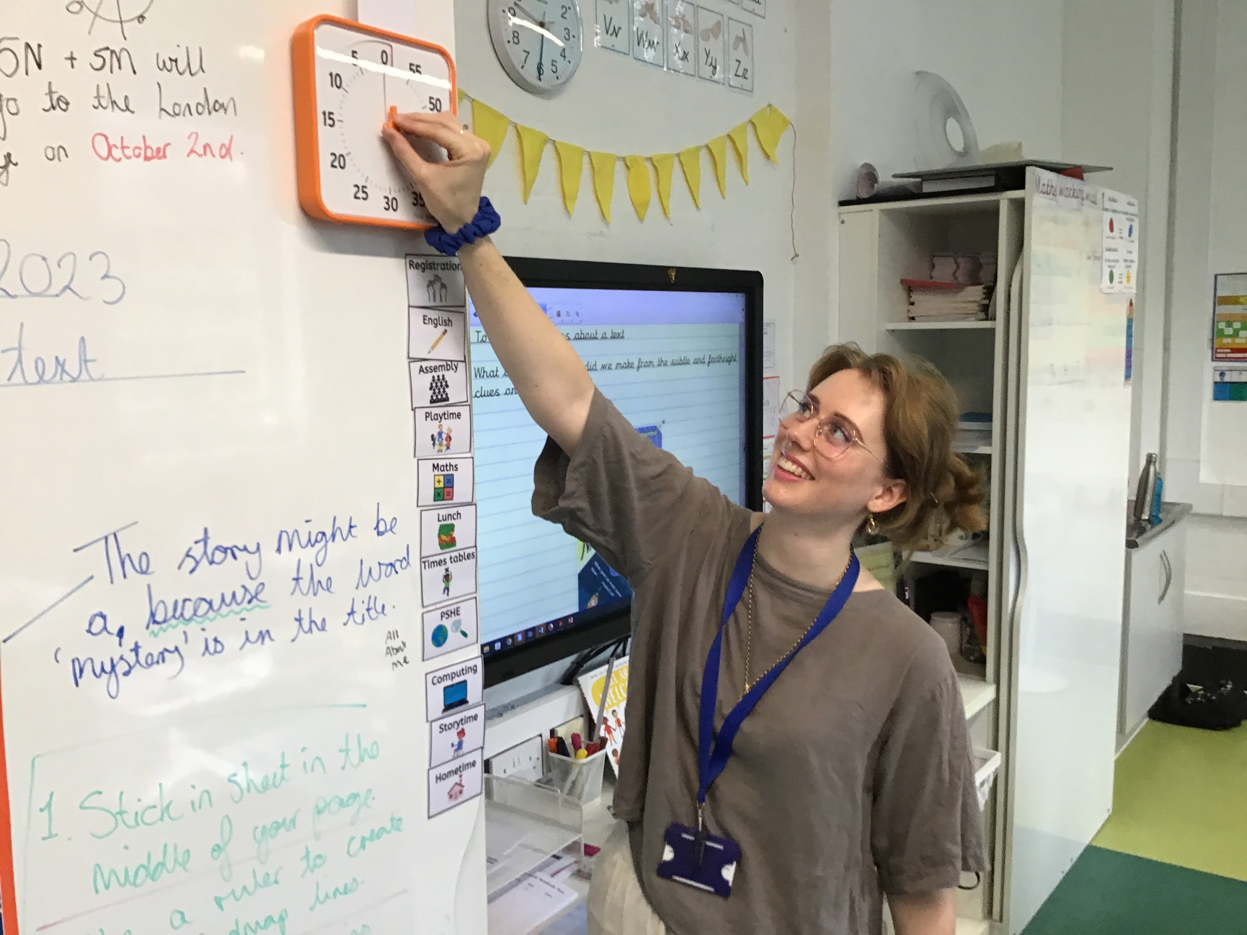
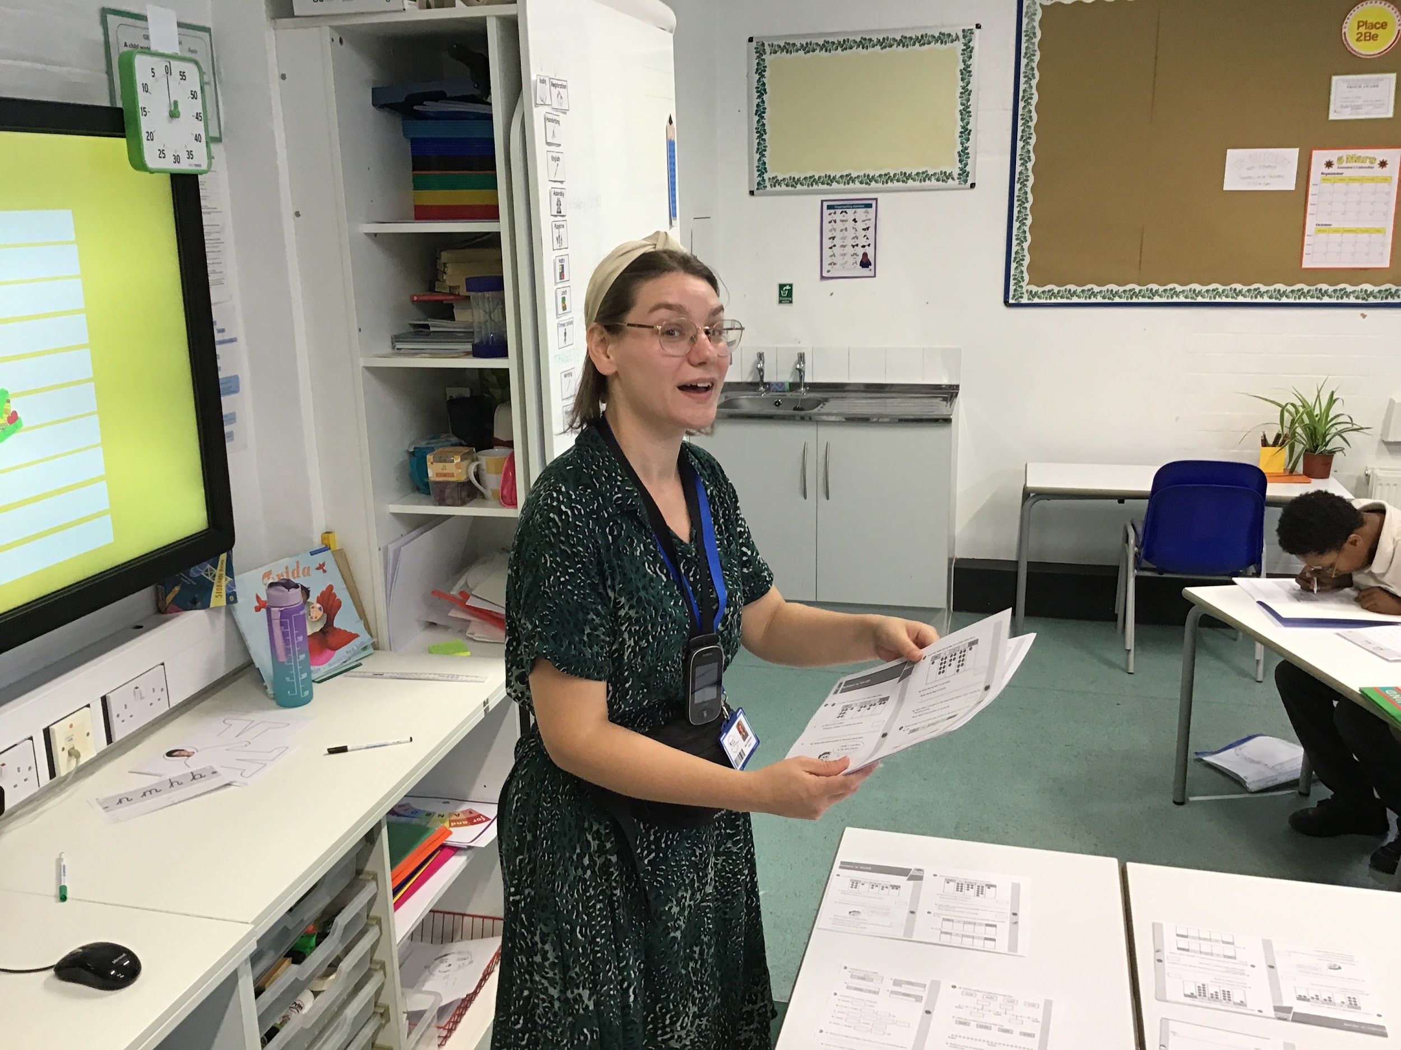
Staff in Year 5
Mr Cowley Class Teacher of 5 Jupiter. Year 5 Lead Teacher. |  | Mrs Cameron Class Teacher of 5 Earth.
Miss Brinkman Class Teacher of 5 Neptune. |  | Miss McKenna Class Teacher of 5 Mars.
*include all adults working with the class including support staff, 1:1 support, ppa cover

Slide 3
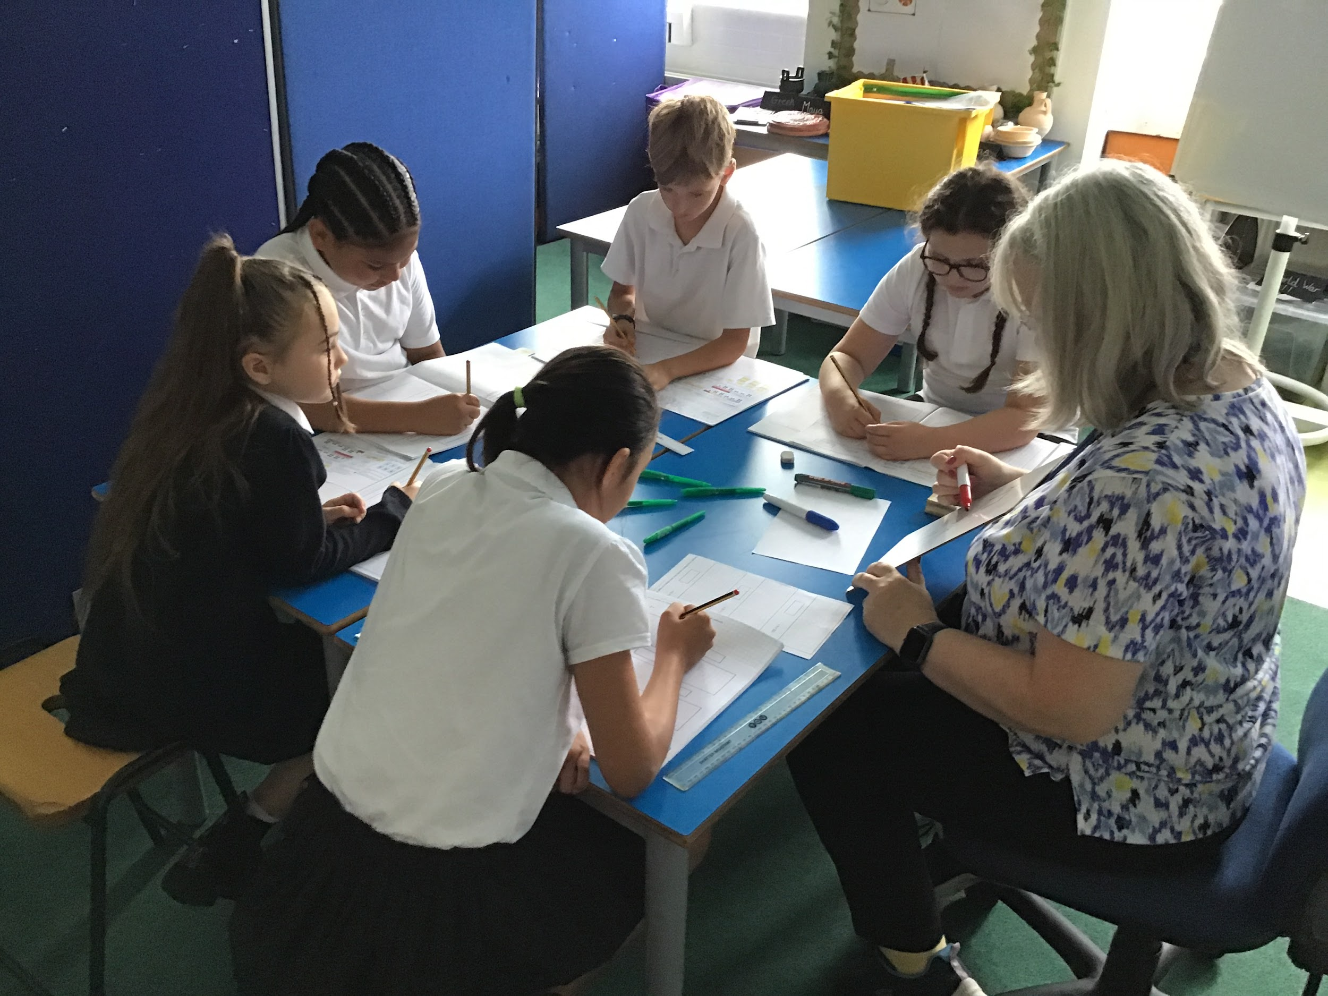
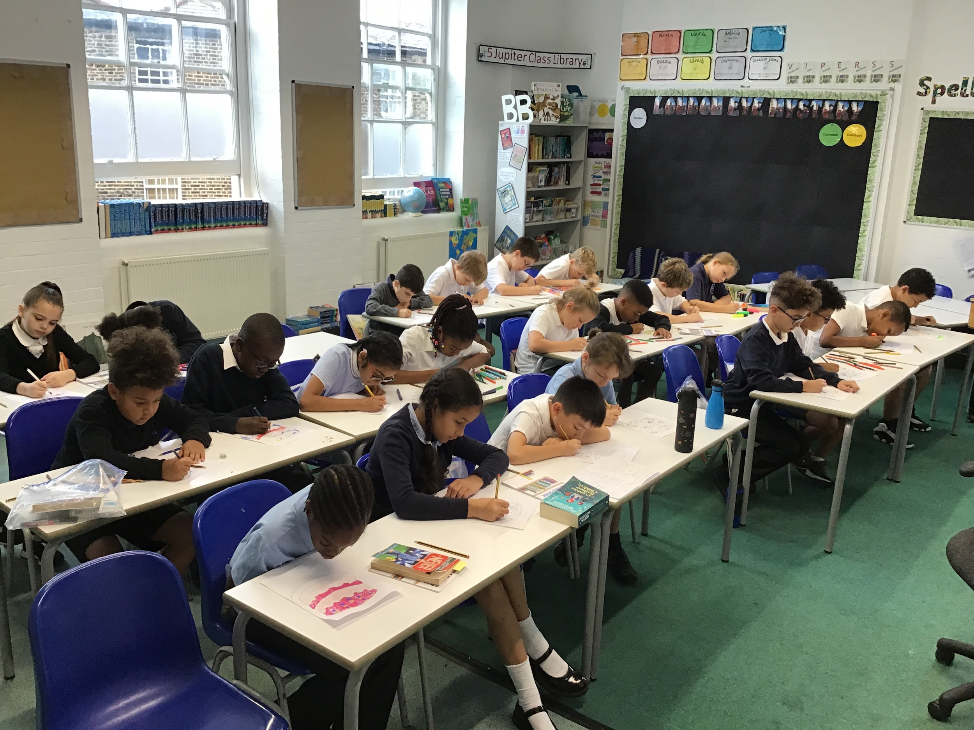
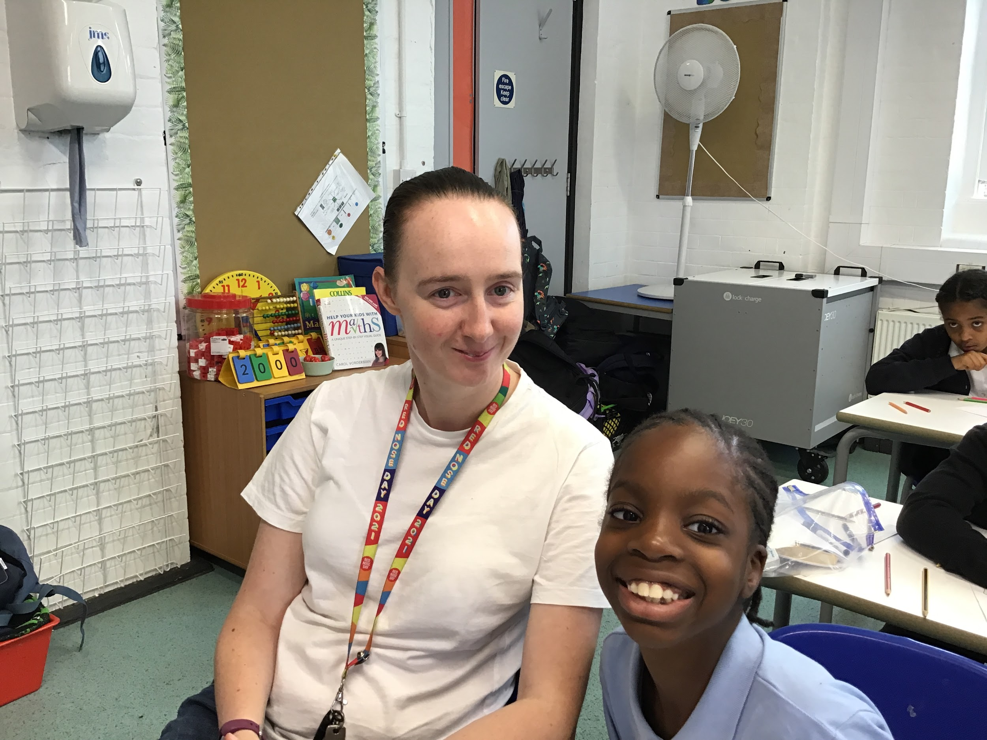
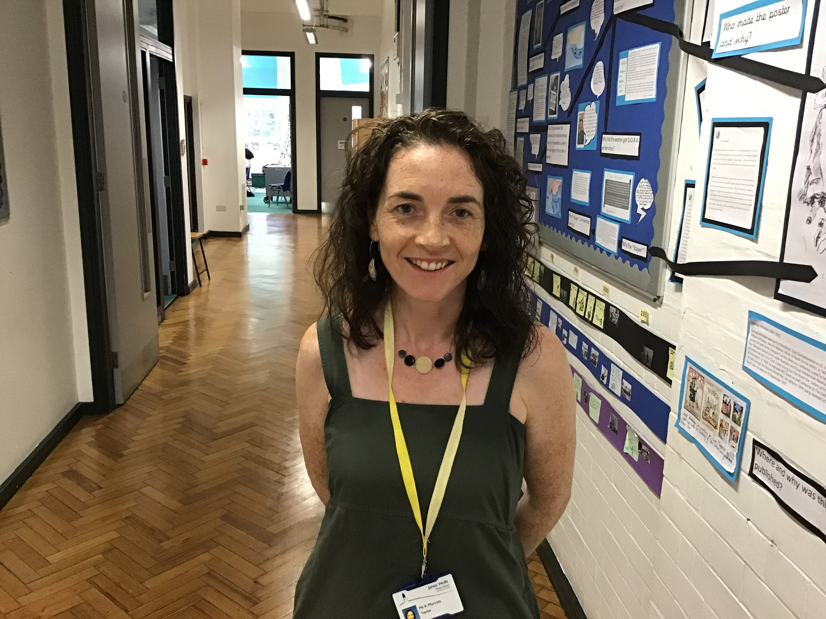
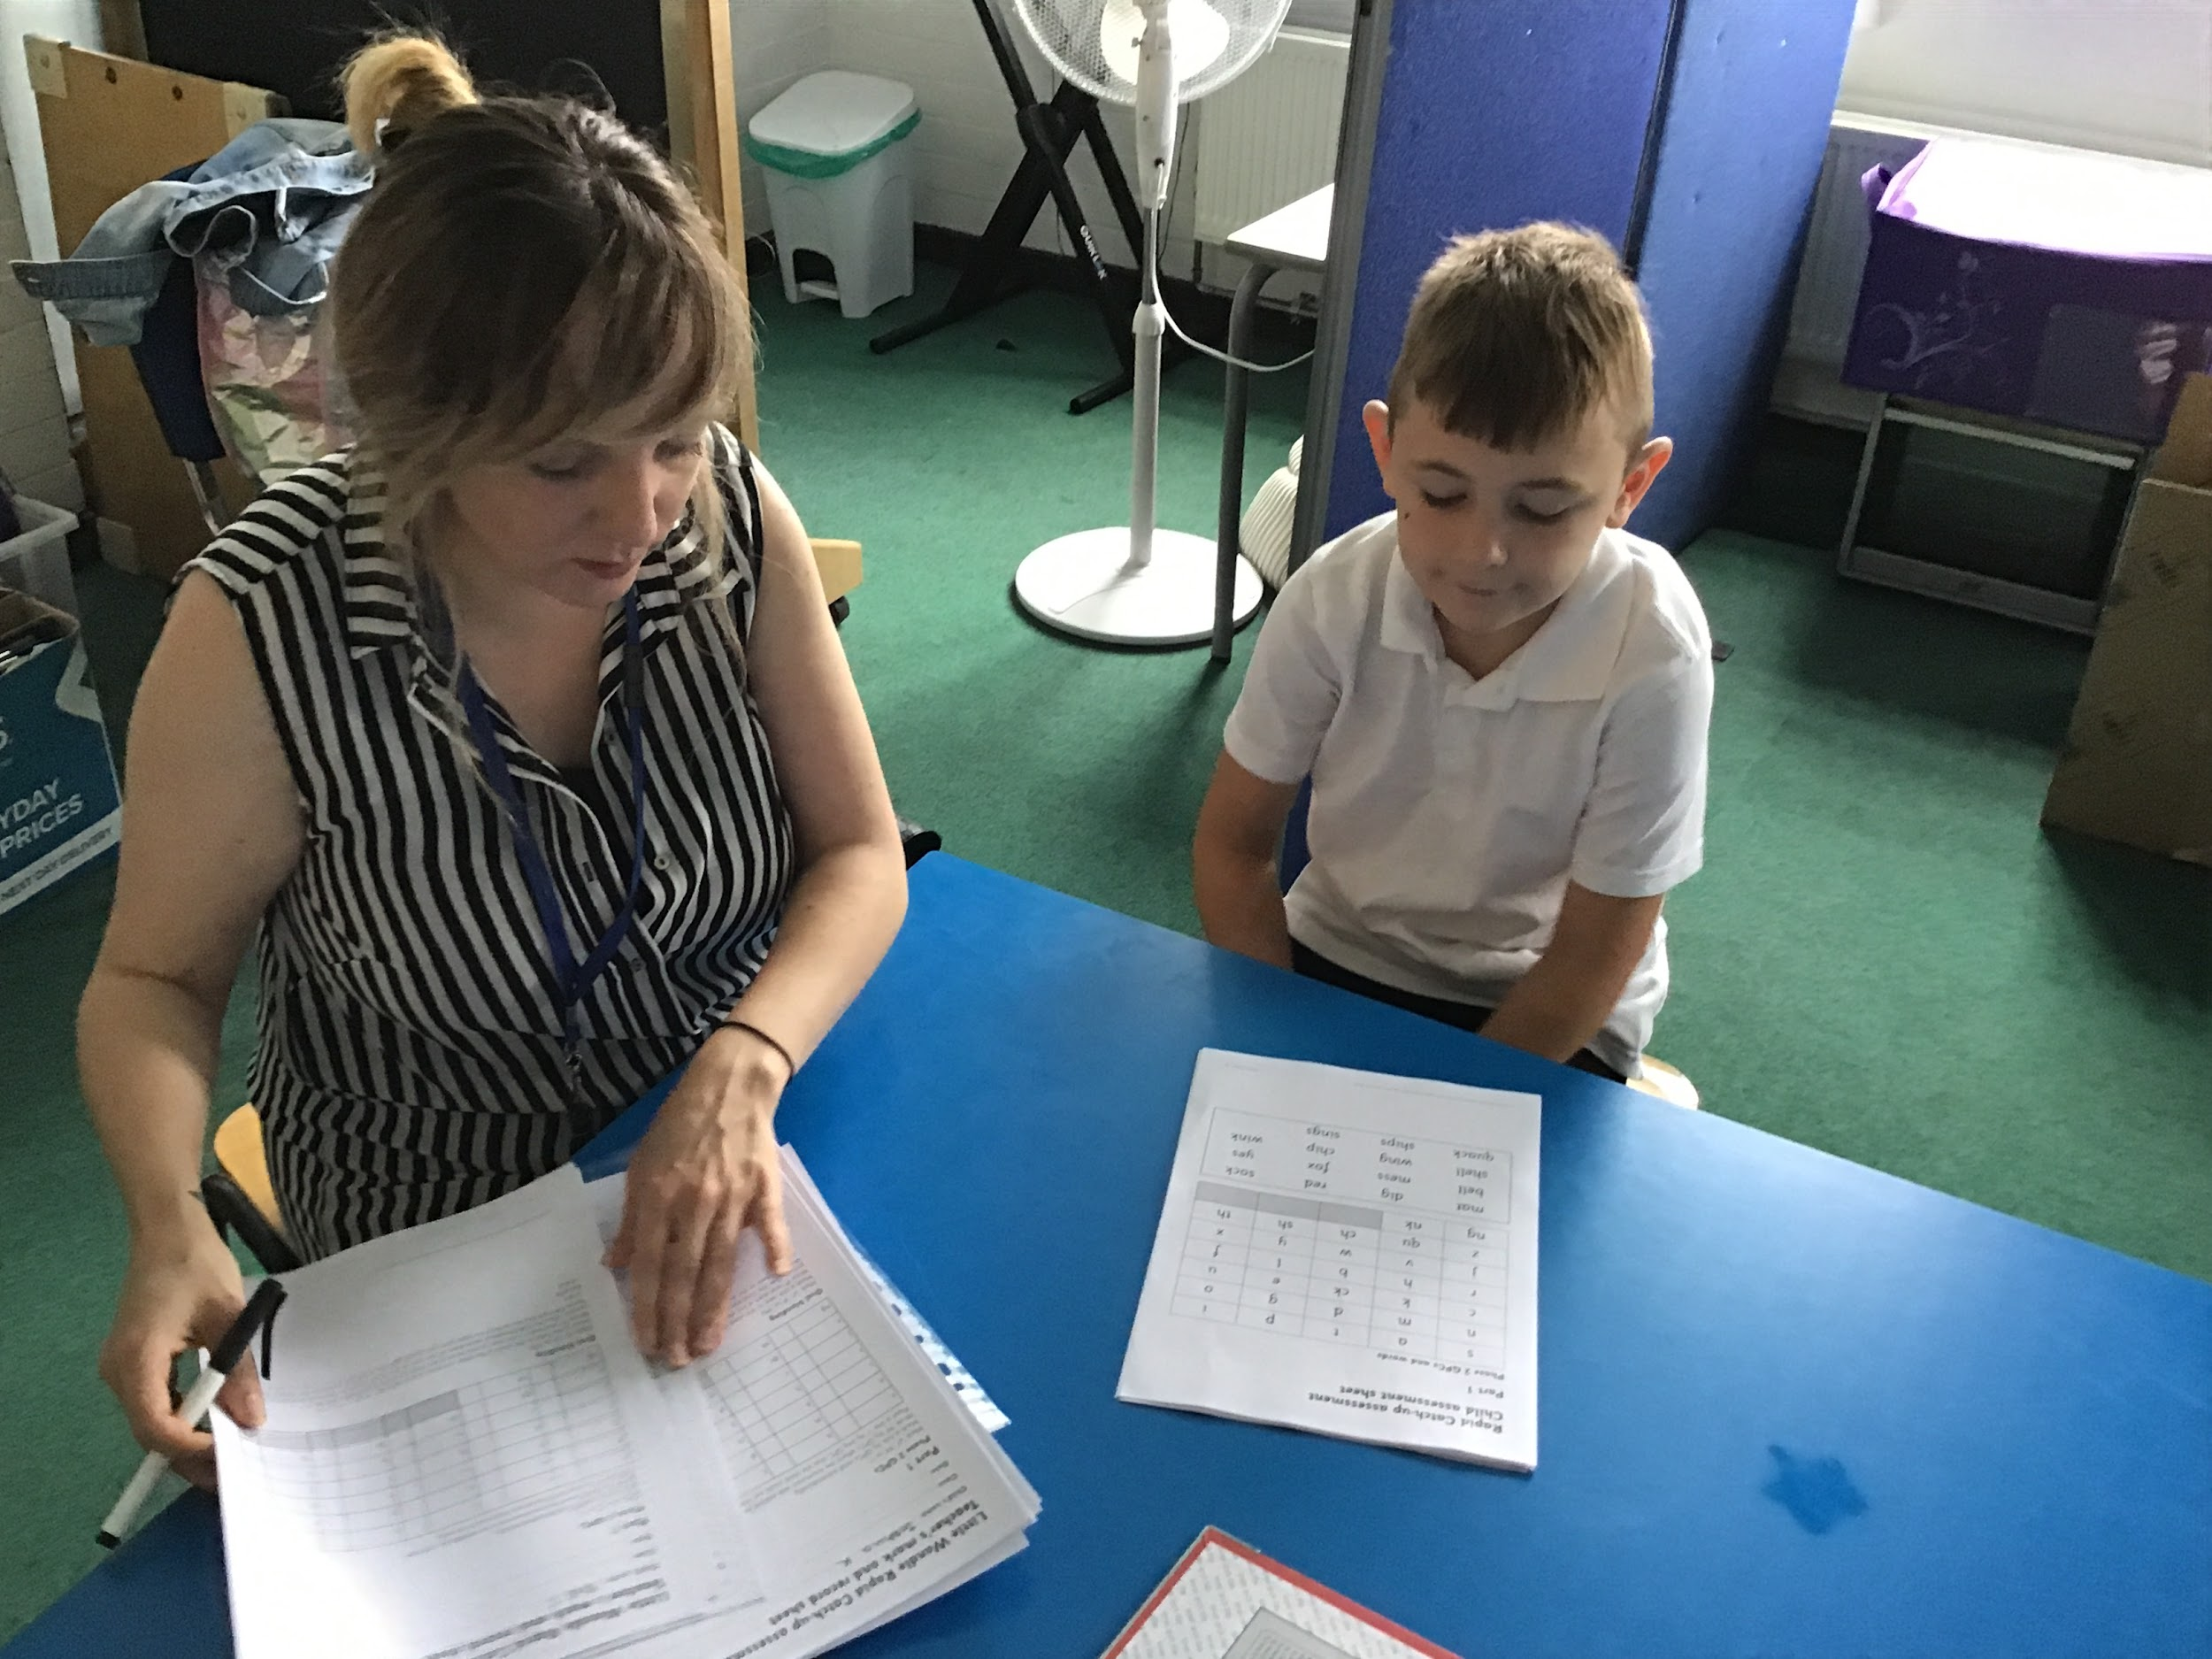
Staff in Year 5
Mrs Butler. Lead Teaching Assistant for Year 5. Intervention Support. |  | Miss Morphitis. 1:1 Teaching Assistant.
Mrs Murcott. Specialist Teacher (phonics). |  | Miss Murray. Phonics Champion.
*include all adults working with the class including support staff, 1:1 support, ppa cover

Slide 4
P.E. Coaches
Ms Saunders |  | Mr Junior
*include all adults working with the class including support staff, 1:1 support, ppa cover

Slide 6
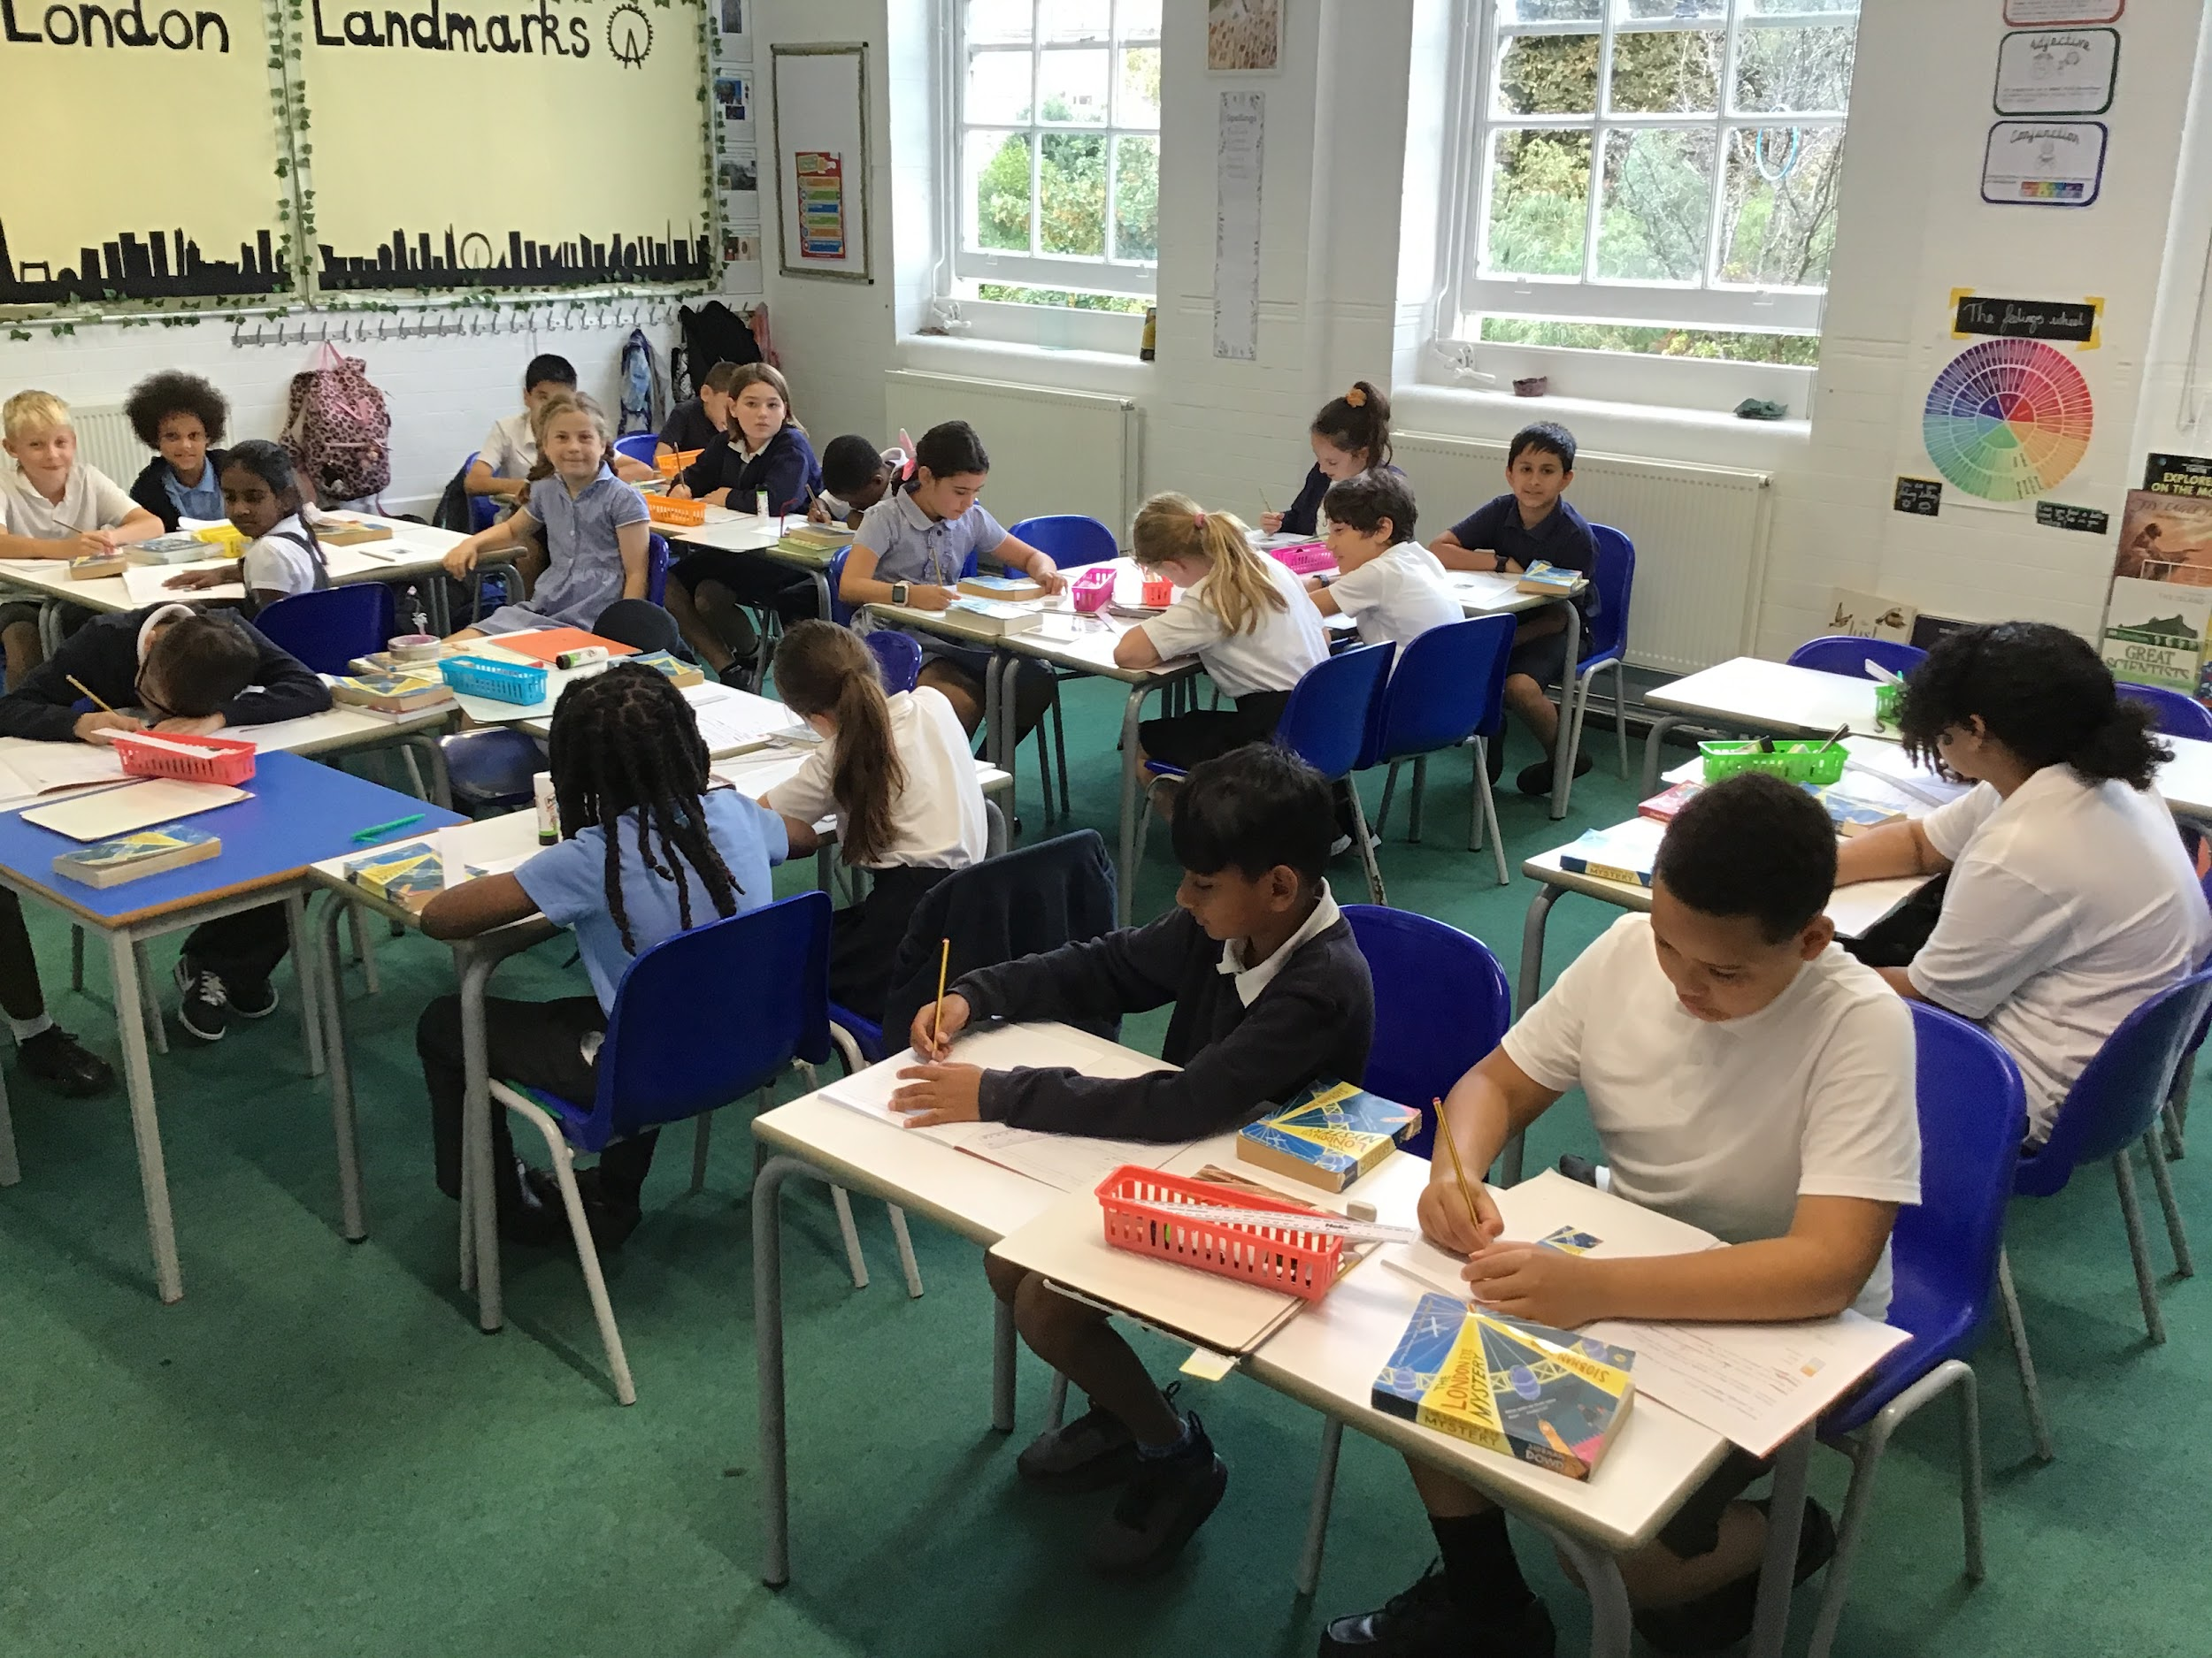
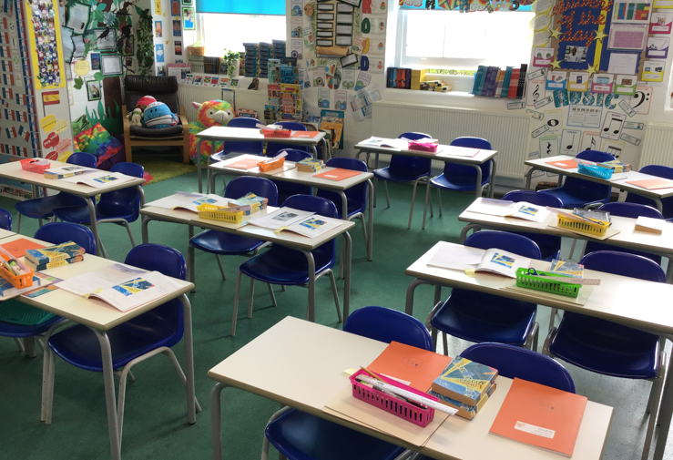
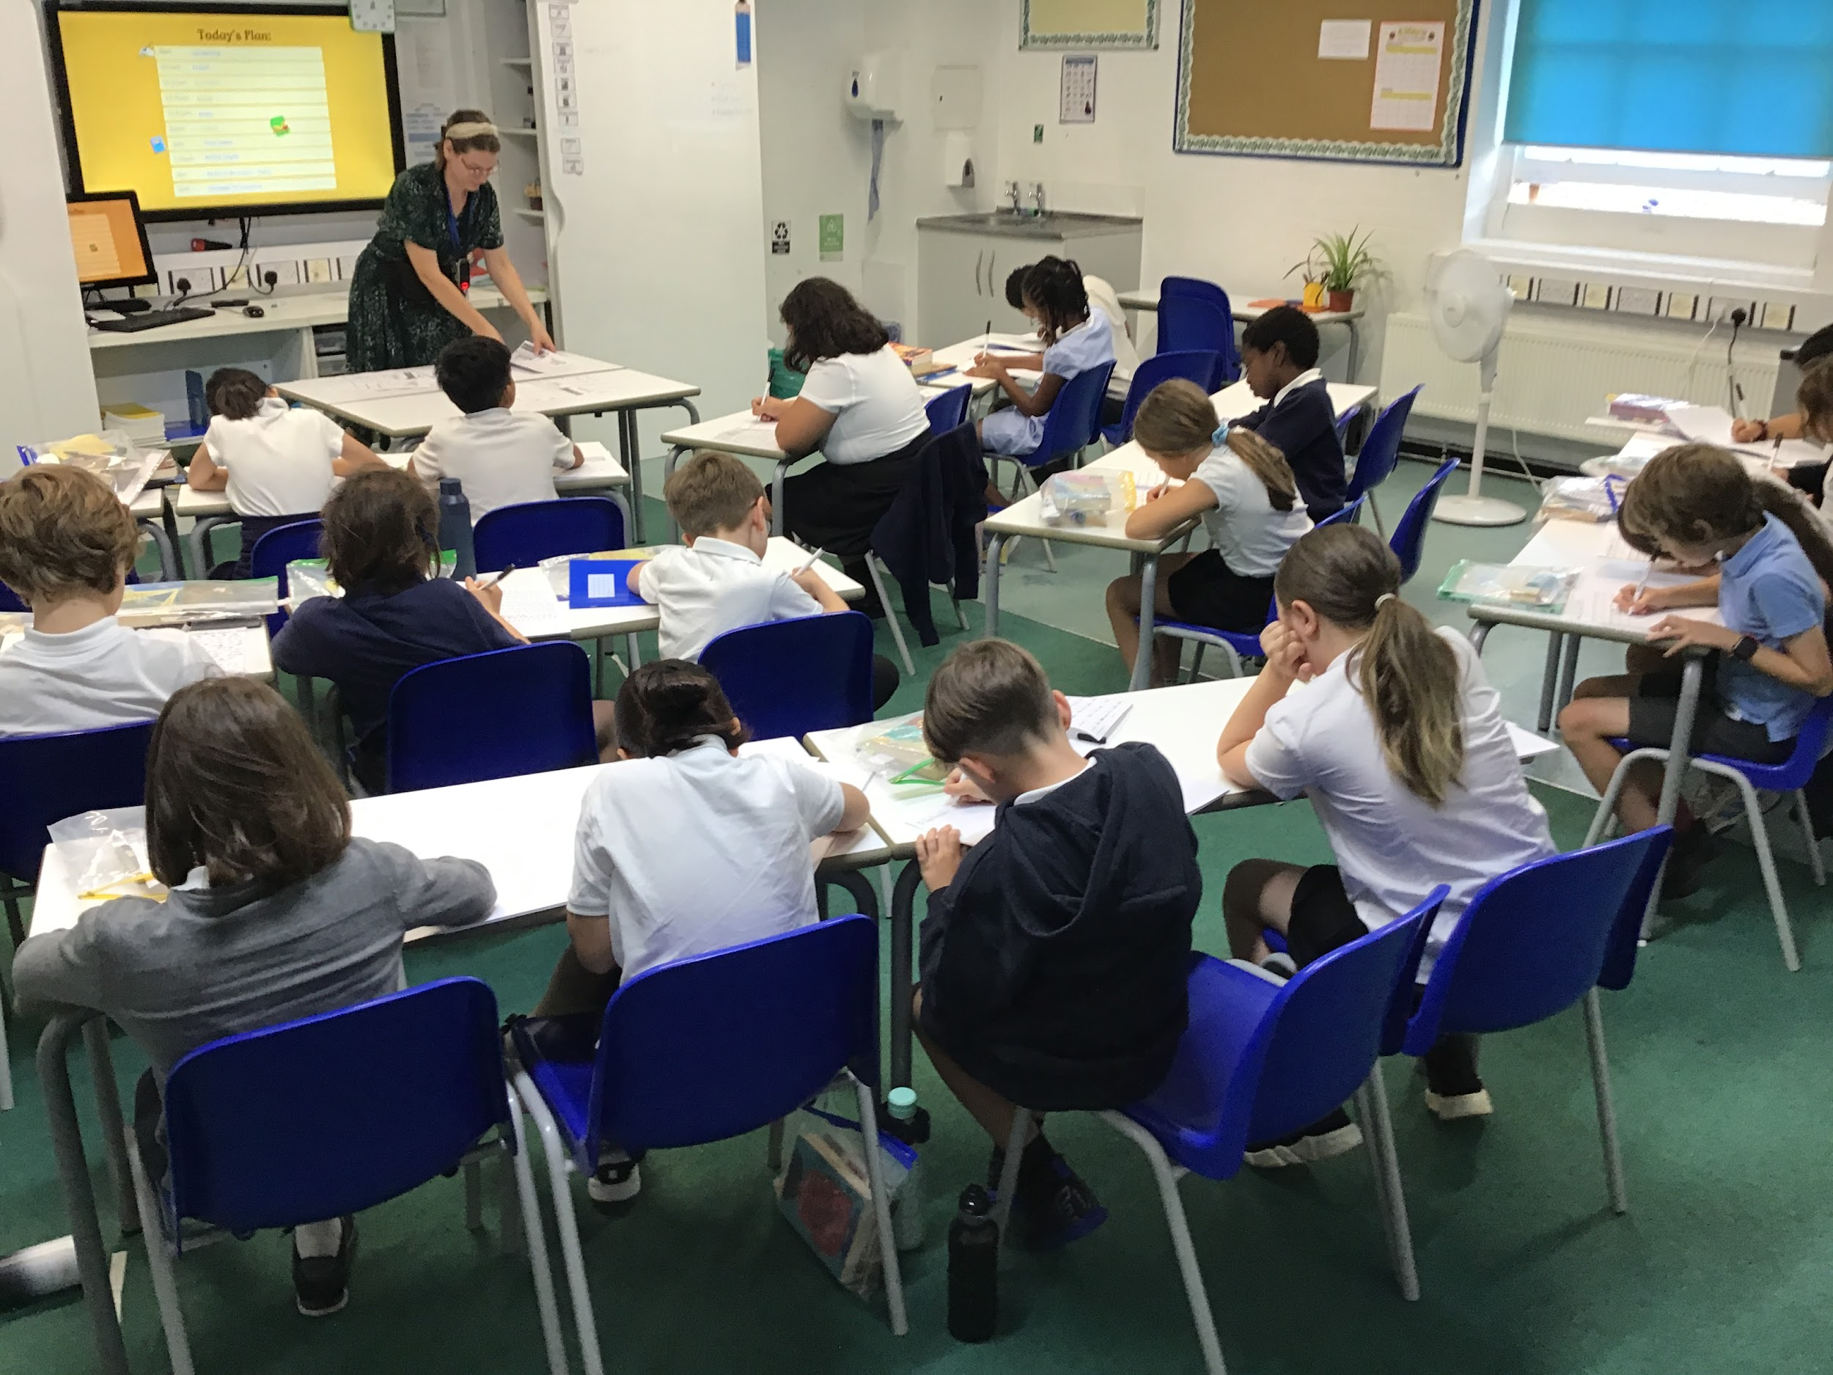
Classroom
5 Jupiter
5 Mars
5 Neptune
5 Earth

Slide 7
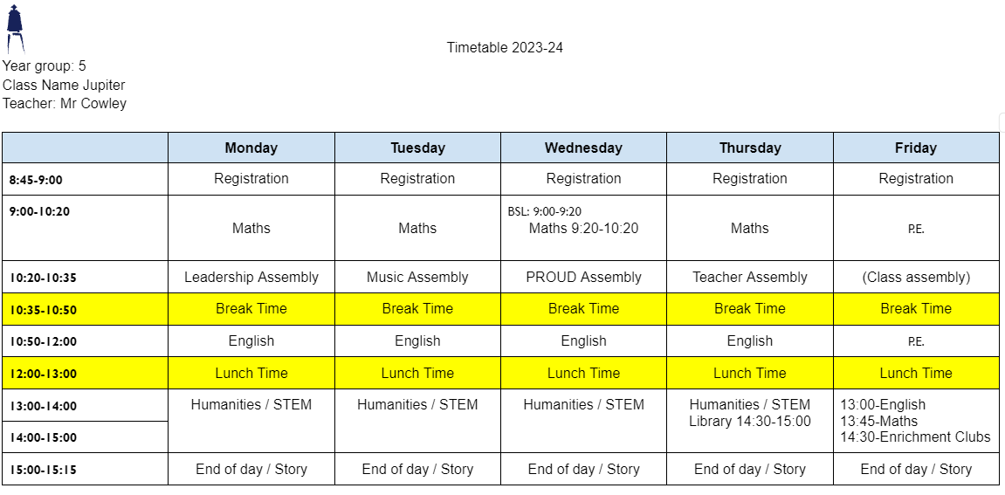
Timetable
Although this is our timetable, things may change. We will prepare children, where appropriate for these changes and inform you if you need to send in PE kit on an alternative day.
P.E. days:
PE Kit: White T shirt, shorts/tracksuit bottoms/sweatshirt in school colours
Trainers/black plimsolls
Swimming: swimming costume/trunks/jammers, towel, swimming hat for long hair. Please note the swimming pool do not permit goggles without a medical note

Slide 8
Drop off and pickups
Children are collected at the end of the day from the same place as morning drop-off, at the side of the school building/playground.
Please inform the school office by 2:30 of any changes to your pick-up routine.
Please be aware that your child will be late if they arrive after 8:45
Year 5- If you would like your child to walk home alone, please email complete the Form here

Slide 9
Uniform
Footwear:Black flat sensible, safe shoes or ankle high boots with good grip on the sole. Alternatively, smart, black trainers with no white or coloured flashes or patterns. Bright coloured laces are not permitted
High heels, flip flops, open-toed sandals, steel toed shoes/boots and greater than ankle high boots are unsafe & not appropriate for school. Pupils may wear boots to/from school but will need to bring a pair of shoes to change into
It is our school policy that all children wear school uniform when attending school. School uniform is part of the school ethos and in sending their child to James Wolfe Primary School, parents agree to support our policy.
Our uniform consists of:
White polo shirt
Navy blue sweater or cardigan (we promote the wearing of jumpers/polo shirts with logos but plain versions in the school colours are acceptable)
Black or grey trousers, shorts or skirts
Blue checked dress
Plain socks or tights in school colours (white, black, navy blue or grey)
Plain headscarves
Plain and discreet headbands and hair ties
A peaked cap for summer protection (sunglasses are not permitted)
Jewellery: It is encouraged that pupils do not wear jewellery to school, especially as individuals become very upset if a treasured piece of jewellery goes missing or is damaged. The only acceptable items of jewellery permitted are small studs for pierced ears and sensible watches. Please note that the school will be unable to take any responsibility for any jewellery/watches lost or damaged.
Make up: No make-up is to be worn to school (this includes nail polish)
Please label all school clothes with your child’s name. We do our best to re-unite children with clothes they leave lying around the playground and building.
Where PE is first session in the morning (Friday for 5 Jupiter/ Neptune) children may come to school in PE kit but must have uniform to change into at the end of their PE session. 5 Mars and Earth may go home in PE kit on Friday.

Slide 10
Homework
Please read with your child for at least 15 minutes, daily and record this in their reading records. Children will have a class reading book and their weekly selection from the school library..
Please practise times tables with your child. Your child has an account on Times Tables Rockstars.
Spellings are accessed via the Spelling Shed website.
Children have a homework book which will have a homework grid with a selection of activities to be completed across the term, one selected activity per week. These can also be found on Google Classroom.

Slide 11
Statutory testing
Year 6
In May 2023, Year 6 pupils will sit their statutory end of Key Stage 2 SATs tests. The children will prepare for these through a broad and balanced curriculum. The teachers will support the children to help them feel confident and reduce any anxiety around the tests. The assessments are an indicator of how well the children have attained at the end of Year 6. You do not need to do anything additional at home to prepare them for these tests but we ask that you continue to read with your child and support them with their homework.

Slide 12
Secondary transition
Delete as appropriate
Apply for a secondary school place | Royal Borough of Greenwich

Slide 13
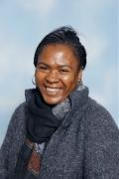
Special educational needs and or disabilities (SEND)
The SEND coordinator (SENDCo) at James Wolfe Primary School and centre for Deaf children is Carol Minkoulou.
If you have any SEND related concerns, please remember that your class teacher is the first point of contact, as they are the people in class with your children each day.
Your class teacher will then share these concerns with Ms Minkoulou so appropriate support can be put in place if needed.

Slide 14
Communication
Class teacher is your first point of contact
Email admin@jameswolfe.greenwich.sch.uk
Weekly Wolfe
School website - https://www.jameswolfe.greenwich.sch.uk/
Trips
To avoid unnecessary workload for parents, you will be informed about the school trips the children are taken on during the day (and we are asking for lots of volunteers!). We ask that you complete one form which will be sent tomorrow giving permission for your child to go on a trip. You will not need to give permission for each trip.
You can however speak to the class teacher for more information about individual trips should you have any queries.

Slide 15
Diary Dates:
London Eye:
Monday 25th September 23 - Y5E
Monday 2nd October 23 - Y5N and Y5M
Monday 9th October 23 - Y5J
Planetarium:
Thursday 9th November - Y5N 10:00 -12:00
Monday 13th November - Y5E 10:00 - 12:00
Monday 13th November - Y5J 13:15 - 15:00
Tuesday 14th November - Y5M 10:00 - 12:00
Year 5 Swimming:
Week from 25/9/23 at 11 am 5 Jupiter
30/10/23 at 11am 5 Earth
13/11/23 at 10 am 5 Neptune
27/11/23 at 11 am 5 Mars

Slide 16
Parent reps
A Parent representative represents all the parents within you class and as well as supporting the Friends of James Wolfe.
The role will involve supporting the teaching with fundraising, helping with FOJW and sharing the views and questions of the whole class, making it much easier to answer questions and queries and take on board suggestions.
We are looking for at least 2 parent reps per year group.
If you would like to be a parent rep, please admin@jameswolfe.greenwich.sch.uk
We will have our first meeting on Friday 22nd September at 9:15am

Slide 17
We are very excited about working with your wonderful children!

