Slide 1
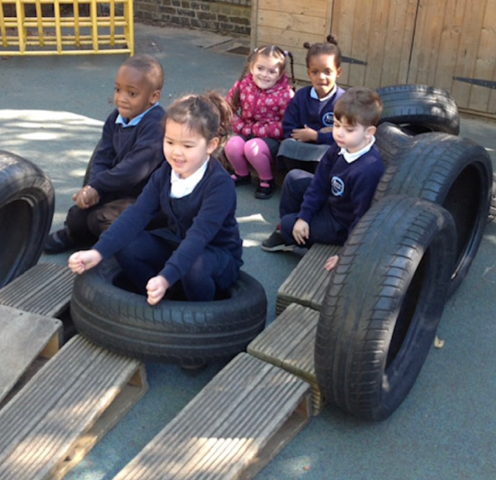
WELCOME TO JAMES WOLFE PRIMARY SCHOOL WITH CENTRE FOR DEAF CHILDREN

Slide 2
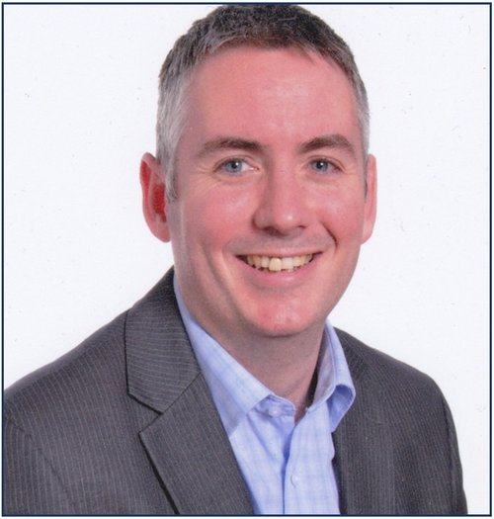
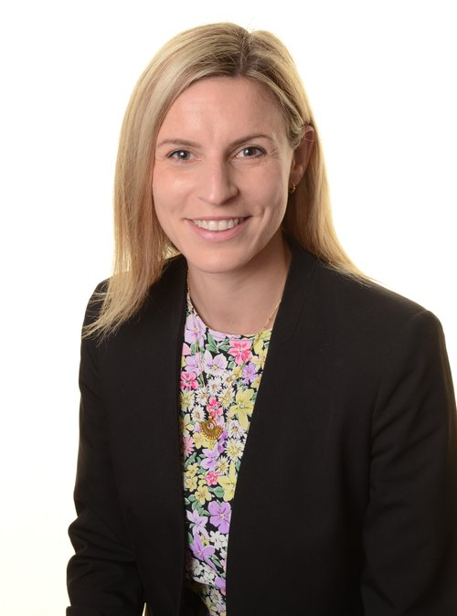
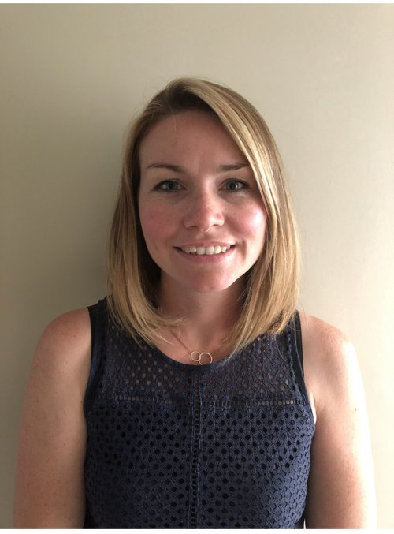
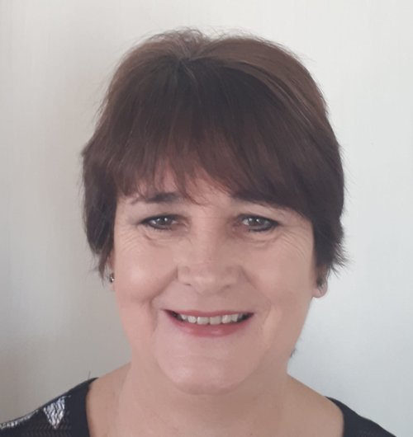
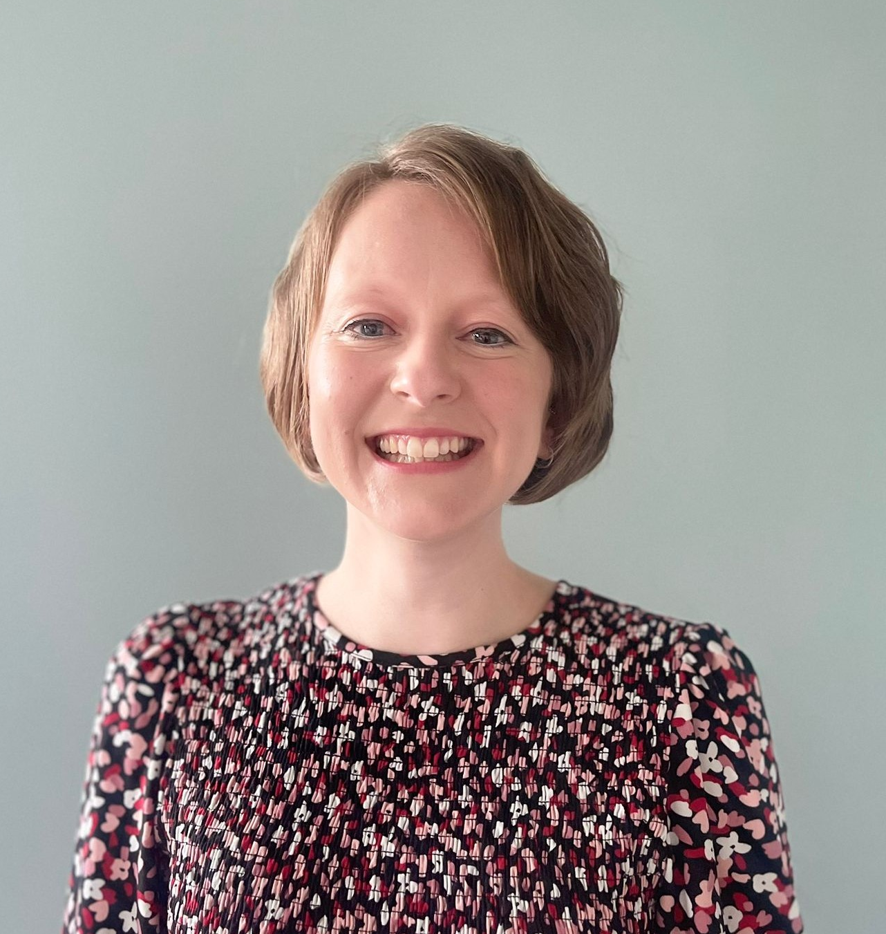
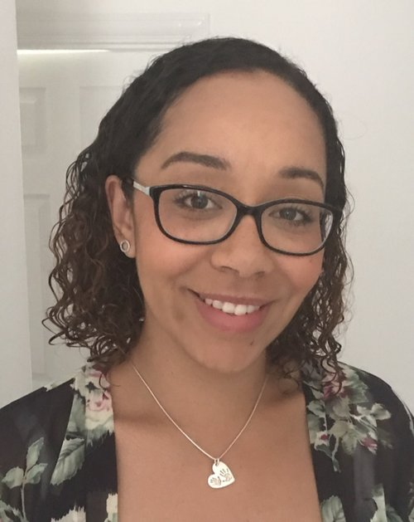
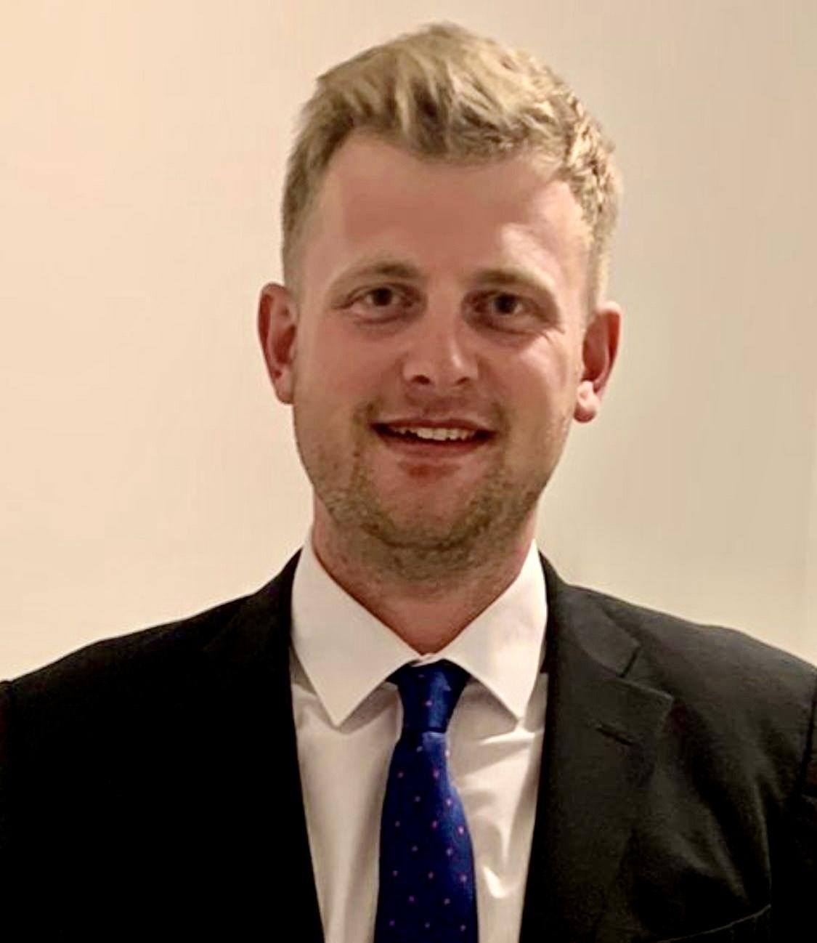
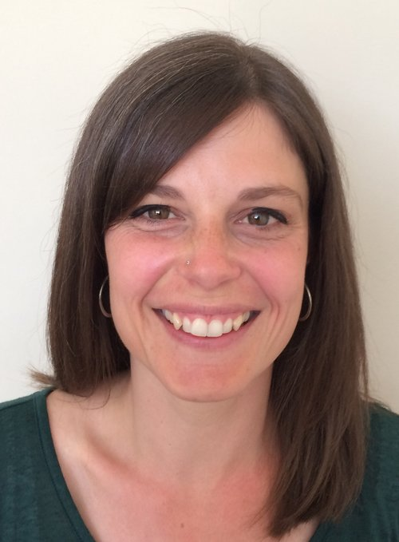
SLT TEAM
Stephen Harris Executive Headteacher | Victoria Gallagher Headteacher | Cheryl Raithby Deputy Headteacher | Gill Sax Business Manager
Jena Price Assistant Headteacher | Siobhan Curtis Assistant Headteacher | Joe Armson Assistant Headteacher | Helen Simpson Assistant Headteacher

Slide 3
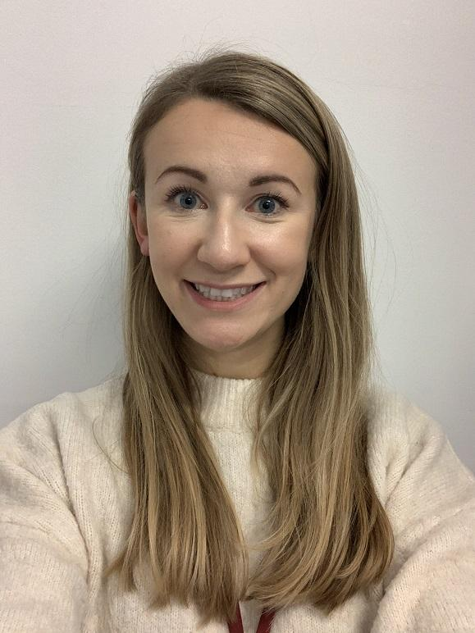
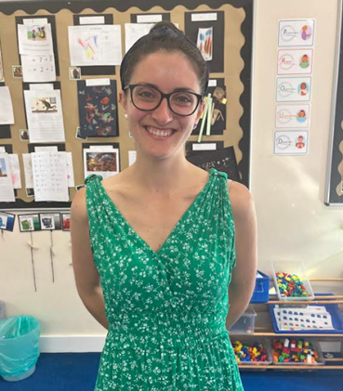
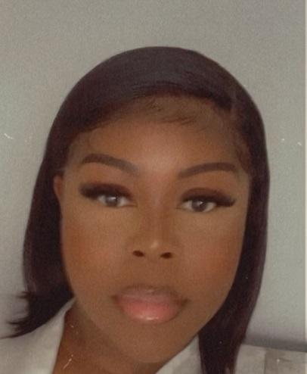
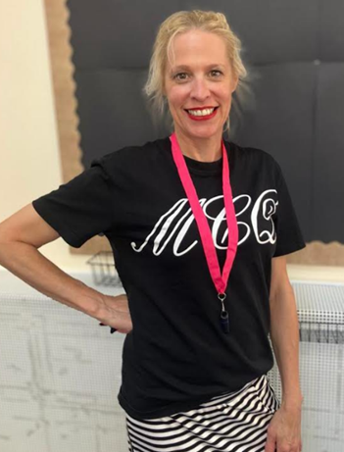
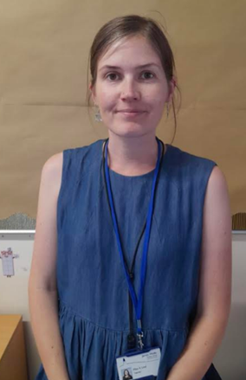
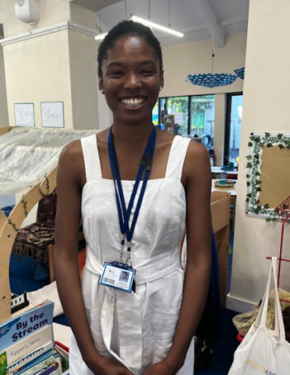
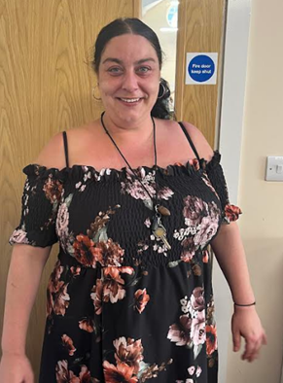
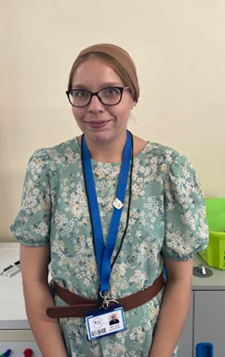
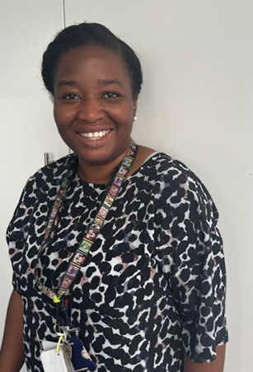
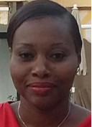
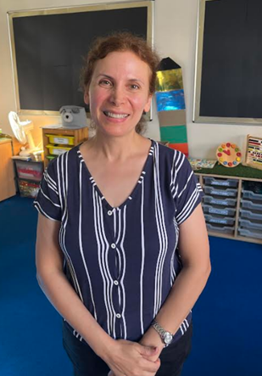
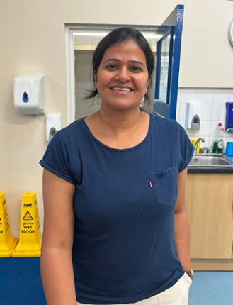
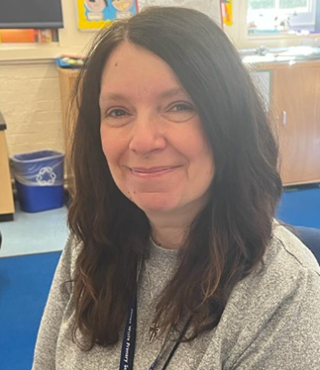
RECEPTION TEAM
Mrs Griffin Reception lead & Mango Class teacher (M-Th) | Ms Syrocki Cherry Class teacher | Ms Seruti Lime Class teacher | Mrs Renouf Peach Class teacher (Th F) | Ms Lind Mango Class teacher (F) | Ms Murray HLTA | Ms Johncock HLTA
Ms Turner Mango Class TA | Ms Parker Cherry Class TA | Ms York-Andrews Lime Class TA | Mrs Ray Peach Class TA | Ms Elham 1:1 TA | Ms Mishra 1:1 TA | Mrs Jones HLTA

Slide 4
IMPORTANT NOTICES
Safeguarding - our first concern must be the welfare of every child in our care.
Attendance and punctuality is really important and we expect 97% attendance or above. If you child’s attendance falls below termly thresholds (95-97%), you will be notified and invited to attend a meeting
Medical needs - parents must complete a form through the office for any medication.
Please ensure all belongings are labelled, such as jumpers, bags and bottles. This helps us to get any lost items back to the right owner.
Ensure children have at school at all times: - spare clothes. - wellies. - water bottles. - coats (during wet and cold weather).

Slide 5
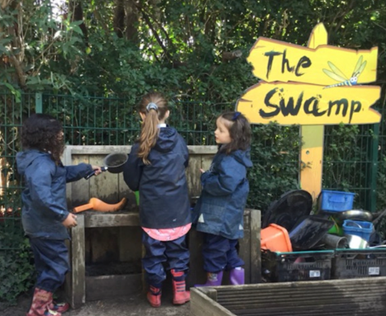
COMMUNICATION
www.jameswolfe.greenwich.sch.uk
Email admin@jameswolfe.greenwich.sch.uk
Open door policy in Reception
Updates on regular communication via The Wolfe
Home learning via Tapestry
Reading mornings - information to come
Parents Evening - 11/10/23 and 12/10/23

Slide 6
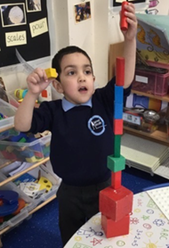
LEARNING IN EARLY YEARS
Prime areas:
Communication and language development
Physical development
Personal, social and emotional development
Specific areas:
Literacy
Mathematics
Understanding the world
Expressive arts and design
Importantly, we learn through play.

Slide 7
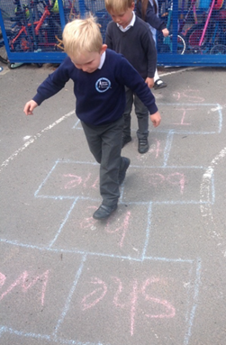
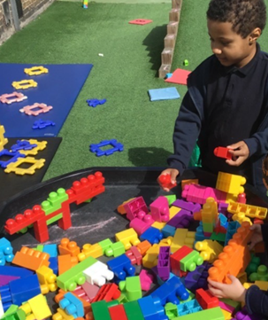
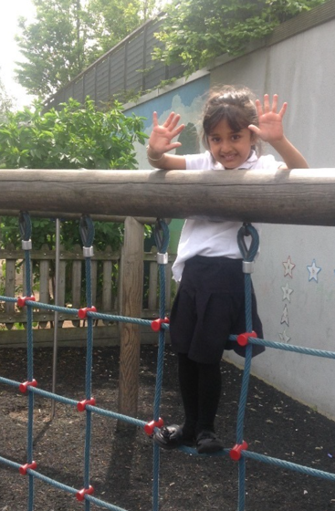
THE RECEPTION DAY
School day: 9:05am – 3:25pm
Our children’s day in Reception is carefully planned over the course of the year. It will start out very similar to the nursery day and, by the end of the year, it will have changed into a model that equips children ready for their start in Year 1.
Daily phonics whole class session – this is where children learn the connection between letters (graphemes) and sounds (phonemes). At James Wolfe, we follow the Little Wandle Letters and Sounds Revised programme to deliver our phonics sessions.
Reading sessions – children read in a small group with an adult three times a week. Additional reading sessions may also take place throughout the week.
Free-flow challenge time where the children get to choose their learning. During this time, children may also work 1:1, or in a small group, with an adult to complete carefully planned activities to support their development of certain skills.
Whole class session – This may have a literacy focus such as developing the children’s speaking and listening skills, exploring a book, role-playing a story or shared reading and writing exercises. Alternatively, the session may link to our topic and develop children’s understanding of the world.
Lunch time
Whole class mathematics session
Free-flow challenge time and small group tasks
Story and song time
Home time
(PE session / Forest School - weekly, after holiday)

Slide 8
PHONICS

Slide 9
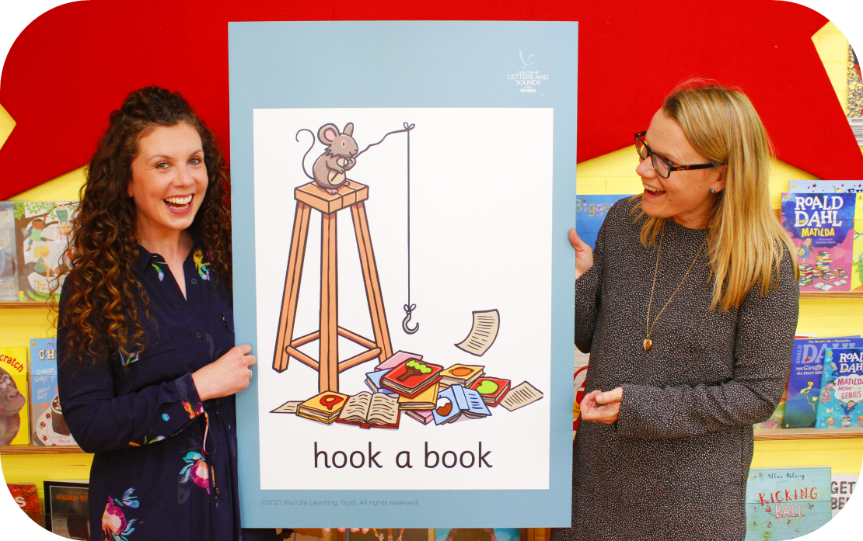
PHONICS
At James Wolfe, we teach phonics using the
Little Wandle Letters and Sounds Revised programme.

Slide 10
PHONICS

Slide 11
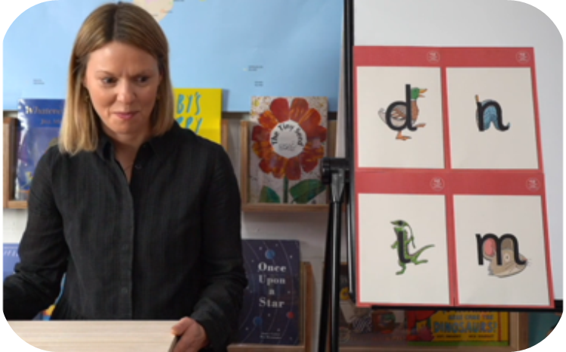
PHONICS
This term, we are teaching Phase 2 of the programme.
These are the first group of letters and sounds that your child will learn. Your child has already been taught the sounds s, a, t, p and i.
The lessons are fun interactive, engaging and have been designed to gradually build over time.

Slide 12
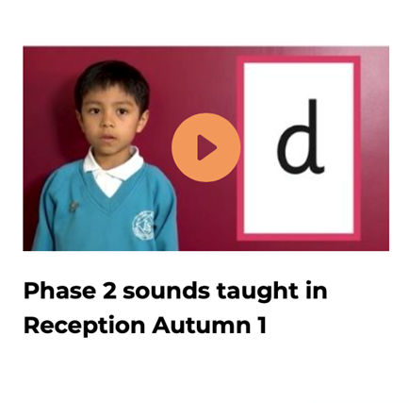
PHONICS
We teach Phase 2 in the following order:
Autumn 1
Autumn 2
There are videos on the Little Wandle website to help you to pronounce the sounds correctly. It is really important to say the pure sound, without a schwa.

Slide 13
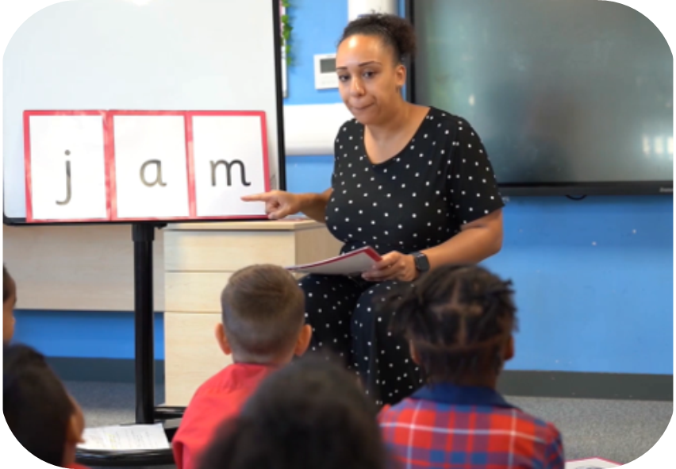
PHONICS
We teach children to blend sounds together so that they can read words.
Teacher-led blending forms a large proportion of our phonics lessons in Phase 2.
We aim to teach every child to blend independently by Christmas. We will inform you if your child needs additional practice.
Teacher-led blending video

Slide 14
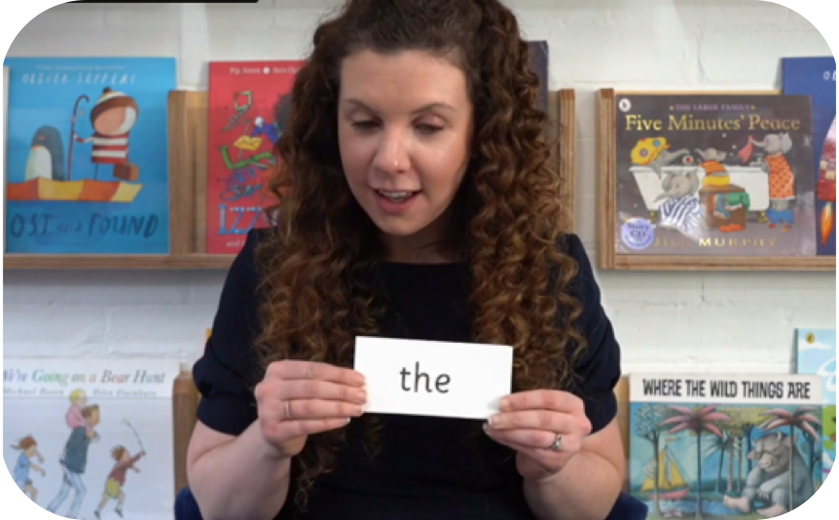
PHONICS
‘Tricky’ words have unusual spellings e.g. he, she, was etc.
They are taught in a systematic way. We teach the children the part of the word that is phonetically decodable and the part of the word that is tricky.
The children are learning to read the following Phase 2 tricky words: is, I, the, put, pull, full, as, and, has, his, her, go, no, to, into, she, push, he, of, we, me, be.
How we teach ‘tricky’ words video

Slide 15
PHONICS
In our phonics lessons, we:
Introduce each new sound with a mnemonic or a phrase to help children to remember them.
Practise blending sounds to read, both with teacher support and independently. We read words that contain the sound that we have learnt that day.
We then read sentences that contain those words
Read tricky words.
Practise writing words that contain our focus sound for the day.

Slide 16
PHONICS
How do we teach spelling?
Your child will be taught how to spell simple words using the graphemes (letters) that they have been taught.
We teach children to:
Say the word e.g. tap
Segment the sounds t-a-p
Count the sounds on their fingers
Write each sound down.
Check that they have included all of the sounds
We use formation phrases to help the children gto form letters correctly. We teach the children to write letters in lower case print first.

Slide 17
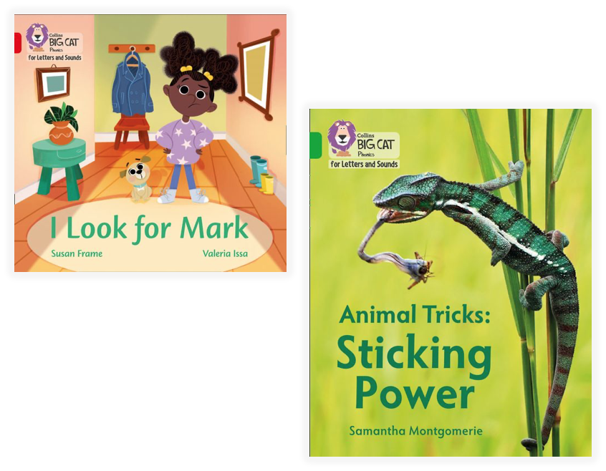
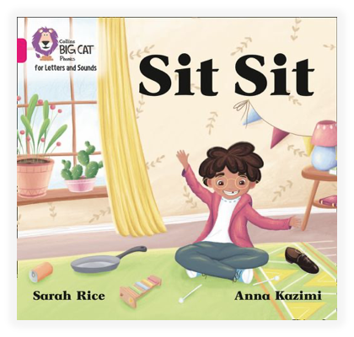
PHONICS
Reading Practice Sessions:
Timetabled 3 times per week.
The children read the same book each time.
Taught in small groups by a trained teacher/TA
We assess the children every 6 weeks to check their progress.
Any child who needs extra support has daily keep-up sessions planned for them.

Slide 18
PHONICS
Reading at Home:
Your child will bring home two books per week; a reading practice book and a shared reading book.
They should be able to read their practice book independently. They might sound out words and blend them before reading them fluently.
The shared reading book is for you to read to your child.
Reading books go home on a Friday and come back on a Thursday. We will start sending books home on Friday 13th October.

Slide 19
PHONICS
Wordless Books:
Until your child can blend, we will send them home with a wordless picture book.
These books are important as they teach important reading skills.
As you read them with your child, talk about the pictures, look at the images in the circles and find them on the page and encourage your child to make links between the books and their own experiences.
You can play oral blending games at home to help your child to blend independently.

Slide 20
MATHS
EYFS Statutory Framework 2023: Children should be able to count confidently, develop a deep understanding of the numbers to 10, the relationships between them and the patterns within those numbers.

Slide 21
MATHS
5
We want children to develop strong concept images of the numbers 1 - 10 and beyond.

Slide 22
MATHS
Subitising helps children to develop strong concept images of numbers.
Perceptual Subitising: The ability to identify a small quantity automatically, without counting.
Conceptual Subitising: The ability to recognise a whole quantity as a result of recognising smaller quantities e.g. I see a 5 and a 2 so it must be 7.

Slide 23
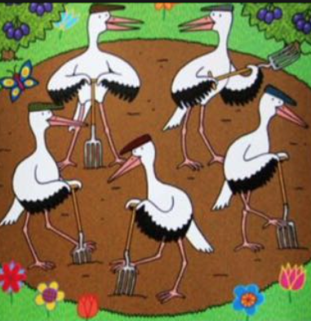
MATHS
How to support subitising at home:
Play board games with a dice
Play dominoes
Look at picture books together and ask the questions:
What do you see?
How do you see it?
Make dot flashcards (up to 6)
‘I see 5 storks…2 at the top and 3 at the bottom.’

Slide 24
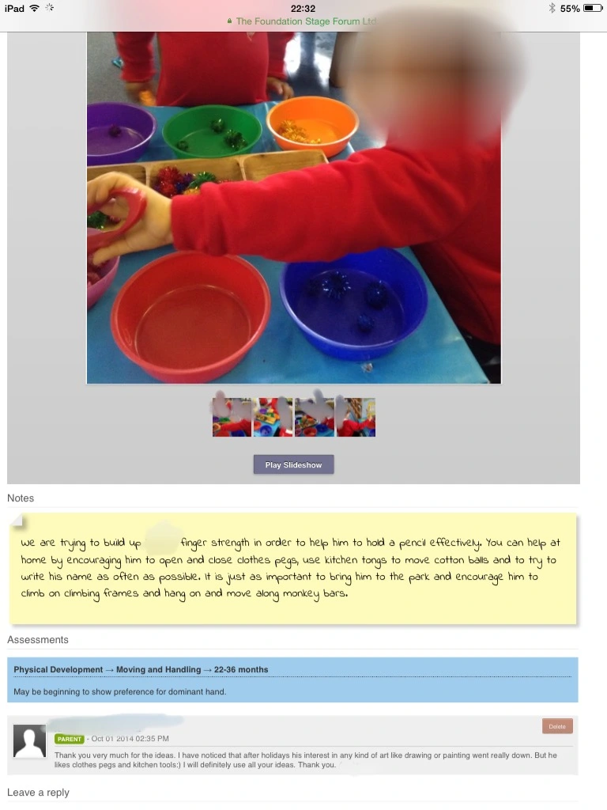
TAPESTRY
Tapestry uses observations to create an individual learning journal for each child.
Photographs, videos and notes are recorded and made available to you.
Allows Reception staff to assess child’s progress as they move through Reception by linking to the ELG.
You can also contribute by commenting on the journal entries or adding your own to share your child’s development at home.
Regular videos will be shared on Tapestry with updates on what we have been learning in Reception (e.g. sounds for you to practise with your child) and other suggestions of how you can deepen their learning at home.
Journal entries are not to be shared on social media.
Permissions for group observations.
Not to be used as a messaging tool to communicate with your child’s class teacher.
Account activation email.

Slide 25
WE ARE PROUD

