Slide 1
Year 1
Welcome to Meet the Teacher
September 2023

Slide 2
Staff in Y1
1S Mr Chaplin
1F Miss McGuire
1H Miss Smith
1W Miss Addae
Support Staff
Mrs Barrett (1S), Miss Zaza (1W), Mrs Smith (1W), Miss Hoxha (1F)
Miss Boreland, Miss Selvage, Mrs Simmons (Across the Year Group)
Mrs Jones (1F PPA and across Year Group)

Slide 4
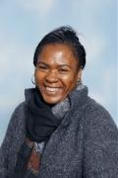
Special educational needs and or disabilities (SEND)
The SEND coordinator (SENDCo) at James Wolfe Primary School and centre for Deaf children is Carol Minkoulou.
If you have any SEND related concerns, please remember that your class teacher is the first point of contact, as they are the people in class with your children each day.
Your class teacher will then share these concerns with Ms Minkoulou so appropriate support can be put in place if needed.

Slide 5
Drop off and pickups
Drop off
Children will be led into the classroom at 09:00
Children start their learning promptly at 09:05
Once doors are closed (09:05) you must enter via the school office
Pick up
Doors will open at 15:30
At 15:35 children will be taken to the school office
Please call the office if you are going to be late

Slide 6
Uniform
Footwear:Black flat sensible, safe shoes or ankle high boots with good grip on the sole. Alternatively, smart, black trainers with no white or coloured flashes or patterns. Bright coloured laces are not permitted
High heels, flip flops, open-toed sandals, steel toed shoes/boots and greater than ankle high boots are unsafe & not appropriate for school. Pupils may wear boots to/from school but will need to bring a pair of shoes to change into.
It is our school policy that all children wear school uniform when attending school. School uniform is part of the school ethos and in sending their child to James Wolfe Primary School, parents agree to support our policy.
Our uniform consists of:
White polo shirt
Navy blue sweater or cardigan (we promote the wearing of jumpers/polo shirts with logos but plain versions in the school colours are acceptable)
Black or grey trousers, shorts or skirts
Blue checked dress
Plain socks or tights in school colours (white, black, navy blue or grey)
Plain headscarves
Plain and discreet headbands and hair ties
A peaked cap for summer protection (sunglasses are not permitted)
Jewellery: It is encouraged that pupils do not wear jewellery to school, especially as individuals become very upset if a treasured piece of jewellery goes missing or is damaged. The only acceptable items of jewellery permitted are small studs for pierced ears and sensible watches. Please note that the school will be unable to take any responsibility for any jewellery/watches lost or damaged.
Make up: No make-up is to be worn to school (this includes nail polish).
Please label all school clothes with your child’s name. We do our best to re-unite children with clothes they leave lying around the playground and building.

Slide 7
PE Day
Tuesday for all classes
Led by PE coaches
Miss Saunders and Mr Junior
1W and 1S in the AM - 1W and 1S arrive at school in PE kits. Bring uniform in a bag
1F and 1H in the PM - 1H and 1F arrive at school in uniform. Bring PE kit in a bag.
PE Kit: White T shirt, shorts/tracksuit bottoms/sweatshirt in school colours
Trainers/black plimsolls

Slide 8
Uniform
Please label everything!
Lost property. It may be…
In the classroom
On a coat peg
Left in the playground/lunch hall
Lost property (Under the blue canopy)
Taken home by another child and hopefully returned

Slide 9
Communication
Class teacher is your first point of contact
Google Classroom
Email admin@jameswolfe.greenwich.sch.uk
Weekly Wolfe
School website - https://www.jameswolfe.greenwich.sch.uk/
Trips
To avoid unnecessary workload for parents, you will be informed about the school trips the children are taken on during the day (and we are asking for lots of volunteers!). We ask that you complete one form which will be sent home giving permission for your child to go on a trip. You will not need to give permission for each trip.
You can however speak to the class teacher for more information about individual trips should you have any queries.

Slide 10
Statutory testing
Year 1
During the summer term (June), the children will take a phonics screening check. The assessments are an indicator of how the children are progressing and achieving at the end of Year 1 in their reading. You will receive further information on this later in the year.

Slide 11
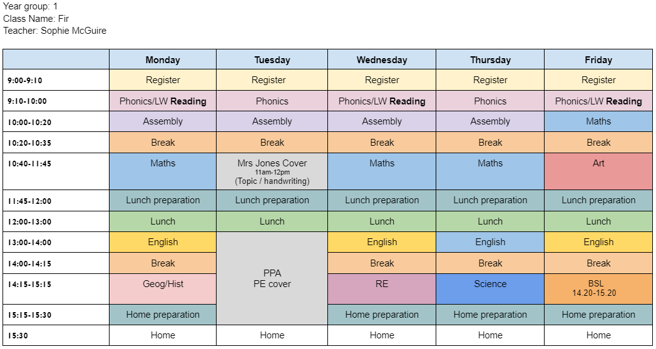
Timetable 1F

Slide 12
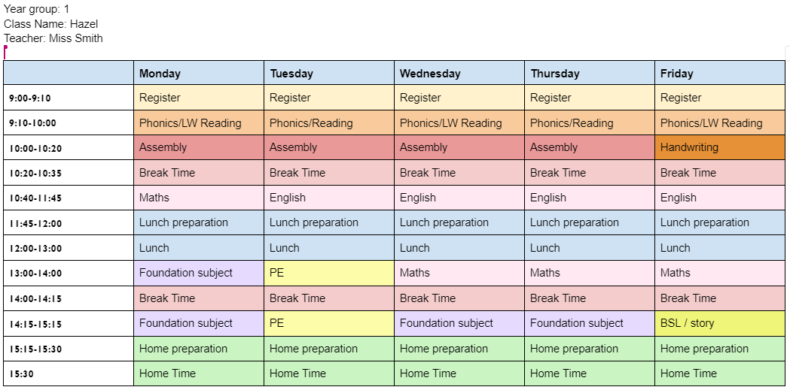
Timetable 1H

Slide 13
Topics
Monsters
Dinosaurs
Pirates
Fairytales
Carnival
Animals

Slide 14
Home Learning
Reception
Year 1

Slide 15
Home Learning
Home learning is not compulsory but is recommended
You can complete home learning either in your home learning exercise book or by uploading to GC. There will be a video on GC to show you how to do this.
There will be a home learning grid each half term for you to use.
Recommend completing 2 activities from the learning grid per week.

Slide 16
Google Classroom
Weekly Newsletter
Learning from week
Phonics sounds/tricky words
Key dates
Ideas for consolidating learning
Weekly Quiz
Links to key texts
Home learning
Links to learning resources
Video clips to show how to use GC

Slide 17
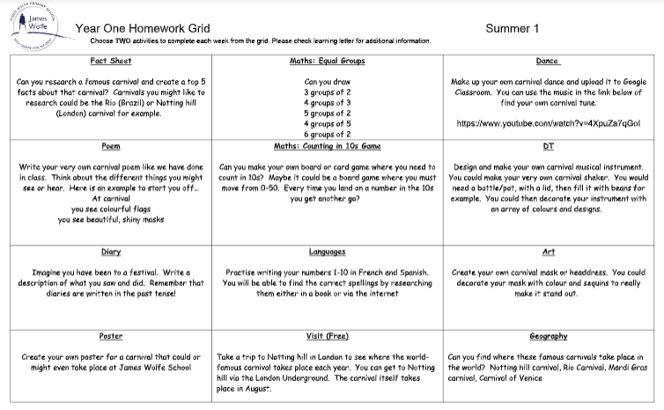
Home Learning

Slide 18
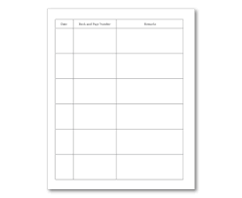
Home Reading
Reading record and LW reading book go home on a Friday
Must be returned by following Friday (Can return during the week)
First books sent home on 22nd September

Slide 19
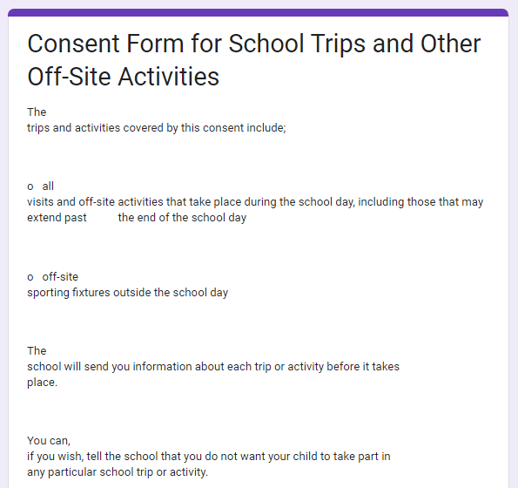
Trips
We will now be asking parents to give their consent for all trips at the beginning of the year via a Google form.
An email will be sent to parents tomorrow with a full explanation and the link to the form.

Slide 20
Parent reps
A Parent representative represents all the parents within you class and as well as supporting the Friends of James Wolfe.
The role will involve supporting the teaching with fundraising, helping with FOJW and sharing the views and questions of the whole class, making it much easier to answer questions and queries and take on board suggestions.
We are looking for at least 2 parent reps per year group
If you would like to be a parent rep, please admin@jameswolfe.greenwich.sch.uk
We will have our first meeting on Friday 22nd September at 9:15am

Slide 21
We are very excited about working with your wonderful children!

