Slide 1
Year 3
Welcome to Meet the Teacher
September 2022

Slide 2
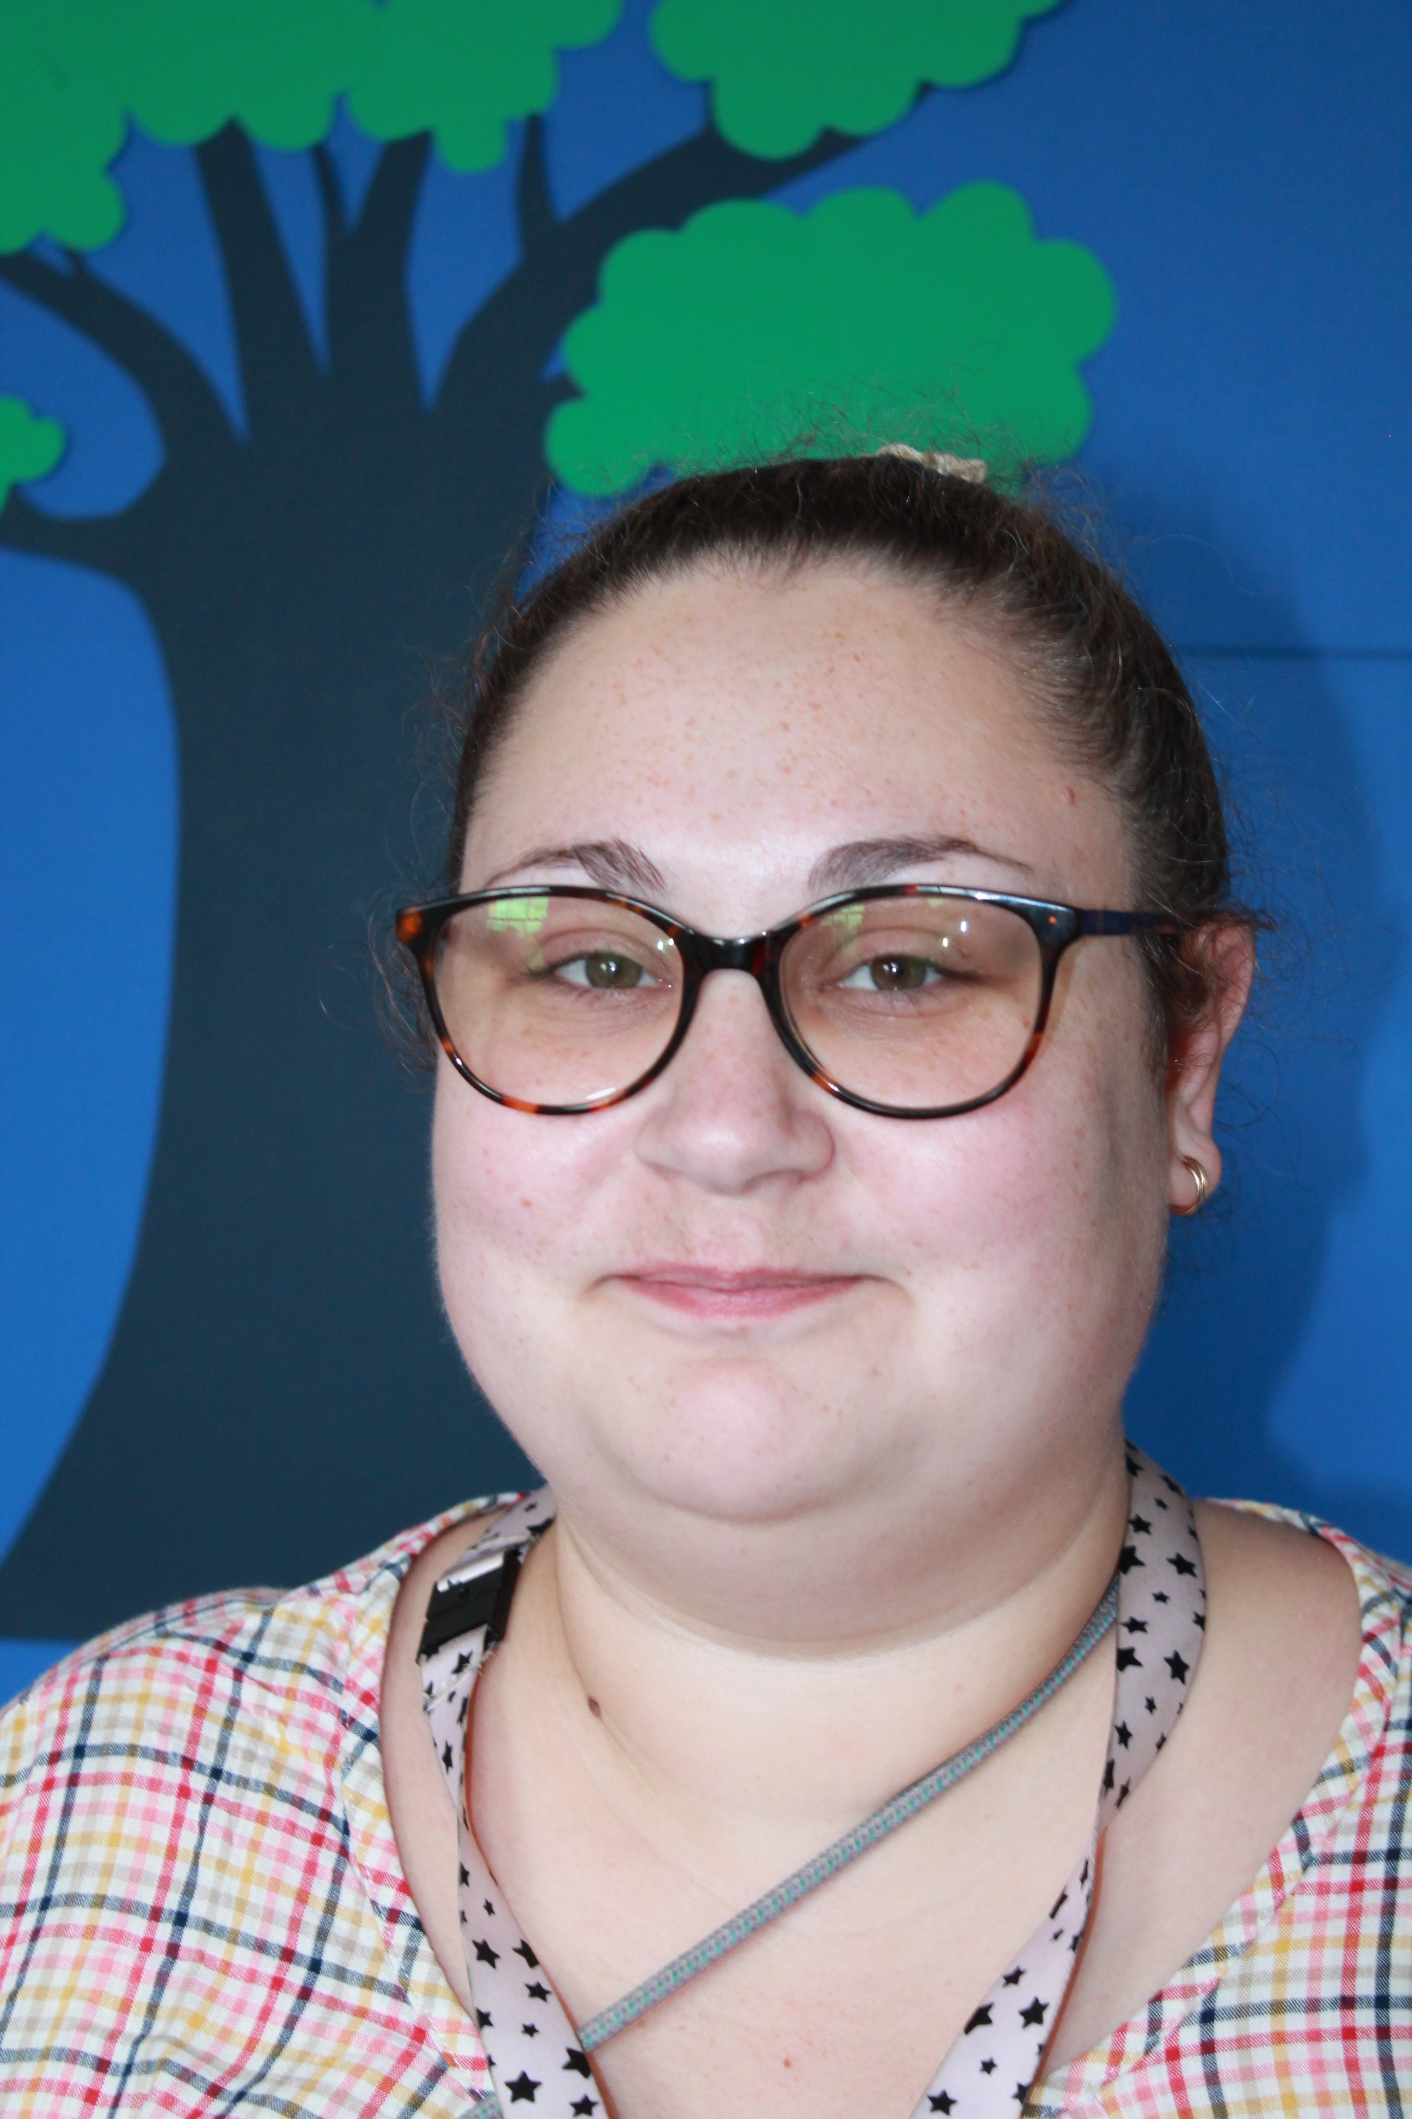
Staff in 3 Poplar
Mrs Joyce (Monday to Wednesday) |  | Miss Johncock Phonic Champion
Ms Lind (Thursday and Friday)

Slide 3
Classroom
3 Poplar

Slide 4
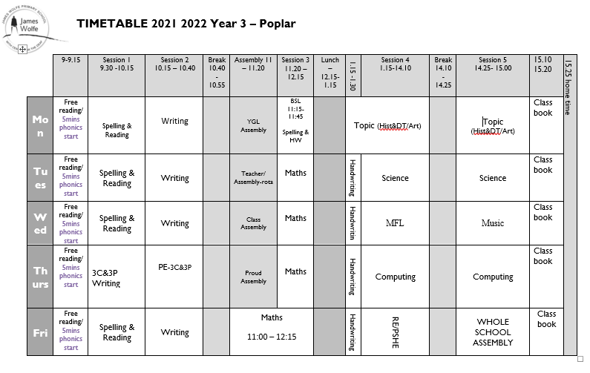
Timetable
Although this is our timetable, things may change. We will prepare children, where appropriate for these changes and inform you if you need to send in PE kit on an alternative day.
P.E. days: Thursday
PE Kit: White T shirt, shorts/tracksuit bottoms/sweatshirt in school colours
Trainers/black plimsolls

Slide 5
Drop off and pickups
3P’s drop off and pick-up is right outside the classroom door.
Drop off is at 8.55am
Pick-up is at 3.25pm
Should you run late, please call the office and let them know. The children will be taken to the office if you are late.
Please be aware that your child will be late if they arrive after 9.05am. Remember that the gate may still be open for Reception children but they will have missed the register in Year 3 and so MUST go to the office before class.
Year 1-3- Please stay with your child until they are collected from the playground.

Slide 6
Uniform
Footwear:Black flat sensible, safe shoes or ankle high boots with good grip on the sole. Alternatively, smart, black trainers with no white or coloured flashes or patterns. Bright coloured laces are not permitted
High heels, flip flops, open-toed sandals, steel toed shoes/boots and greater than ankle high boots are unsafe & not appropriate for school. Pupils may wear boots to/from school but will need to bring a pair of shoes to change into
It is our school policy that all children wear school uniform when attending school. School uniform is part of the school ethos and in sending their child/ren to James Wolfe Primary School, parents agree to support our policy.
Our uniform consists of:
White polo shirt
Navy blue sweater or cardigan (we promote the wearing of jumpers/polo shirts with logos but plain versions in the school colours are acceptable)
Black or grey trousers, shorts or skirts
Blue checked dress
Plain socks or tights in school colours (white, black, navy blue or grey)
Plain headscarves in school colours
Plain and discreet headbands and hair ties
A peaked cap for summer protection (sunglasses are not permitted)
Jewellery: It is encouraged that pupils do not wear jewellery to school, especially as individuals become very upset if a treasured piece of jewellery goes missing or is damaged. The only acceptable items of jewellery permitted are small studs for pierced ears and sensible watches. Please note that the school will be unable to take any responsibility for any jewellery/watches lost or damaged.
Make up: No make-up is to be worn to school (this includes nail polish)
Please label all school clothes with your child’s name. We do our best to re-unite children with clothes they leave lying around the playground and building.

Slide 7
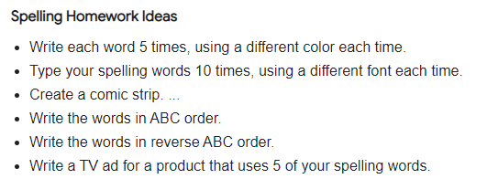
Homework
Please read with your child for at least 15mins 5 days a week and record this in their reading records. The children should get either a book of their own choice or they will be directed to a book at an appropriate level for them (possibly phonologically linked).
Please practise timestables with your child. Your child has an account on Timestable Rockstars but this program focusses on division and we do not teach division as the inverse of multiplication until later in the year- We will let you know!
Spellings –we will follow a phonic based spelling programme in Year 3 you will find spellings under Homework on Google Classroom. Please practise the words for that week.

Slide 8
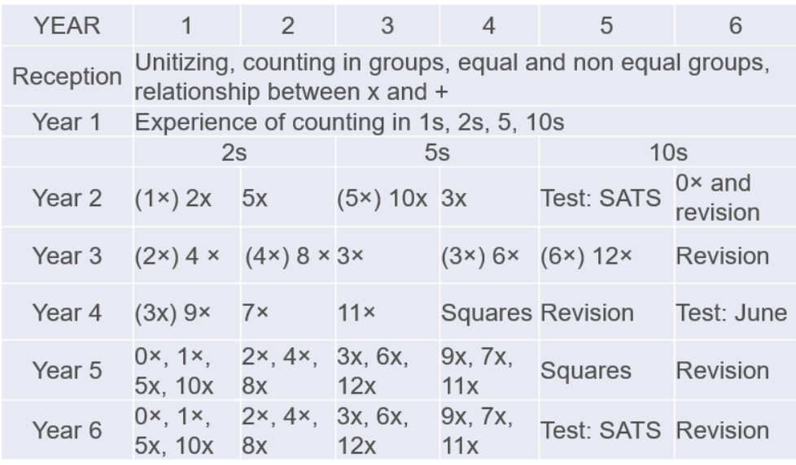
Statutory testing
Delete as appropriate
Year 3
In Juneof Year 4, the children will take a Multiplication test. The purpose of the MTC is to make sure the times tables knowledge is at the expected level so that they can access the Year 5 curriculum.
We start that journey here in Year 3. The teachers will be working on these with the children in class but a good way to prepare is start early and build a daily routine practising the times tables. The children also have access to Timestable Rockstars. We will share their login details with the children and share with families within the first few weeks of term. With regular practise the children will learn all the questions and gain confidence.

Slide 9
Special educational needs and or disabilities (SEND)
The SEND coordinator (SENDCo) at James WOlfe Primary School and centre for Deaf children is Carol Minkoulou
If you have any SEND related concerns, please remember that your class teacher is the first point of contact, as they are the people in class with your children each day. Your class teacher will then share these concerns with Ms Minkoulou so appropriate support can be put in place if needed.

Slide 10
Communication
Class teacher is your first point of contact- admin@jameswolfe.greenwich.sch.uk.
You will receive a termly class newsletter via email, the website and Google Classroom.
Weekly learning updates will be posted on Google Classroom above the homework grid.
Trip and information letters are printed, emailed and posted on Google Classroom.
School website - https://www.jameswolfe.greenwich.sch.uk/

Slide 11
We are very excited about working with your wonderful children!

