Slide 1
Year 2 Elm
Welcome to Meet the Teacher
September 2022

Slide 2
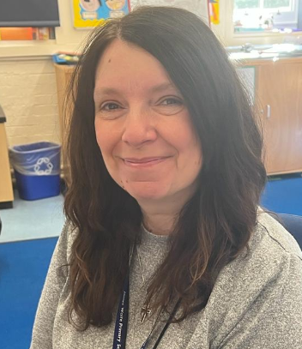
Other staff in 2 Elm
Mrs Remzie-Fraser - Teaching Assistant
Miss Parker - Teaching Assistant
Mrs Chambers - Teaching Assistant
Ms Zaza - Teaching Assistant
Ms Jones
PPA cover (Monday Morning)

Slide 3
Drop off and pickups
Please drop off and collect from the Year 2 area.
Please stay with your child until they are collected from the playground.
Please be aware that your child will be late if they arrive after 9:10am
Important Notice
Children can only be collected by someone over 16 years old.
Please inform the school as early as possible if your child will be collected by another person.

Slide 4
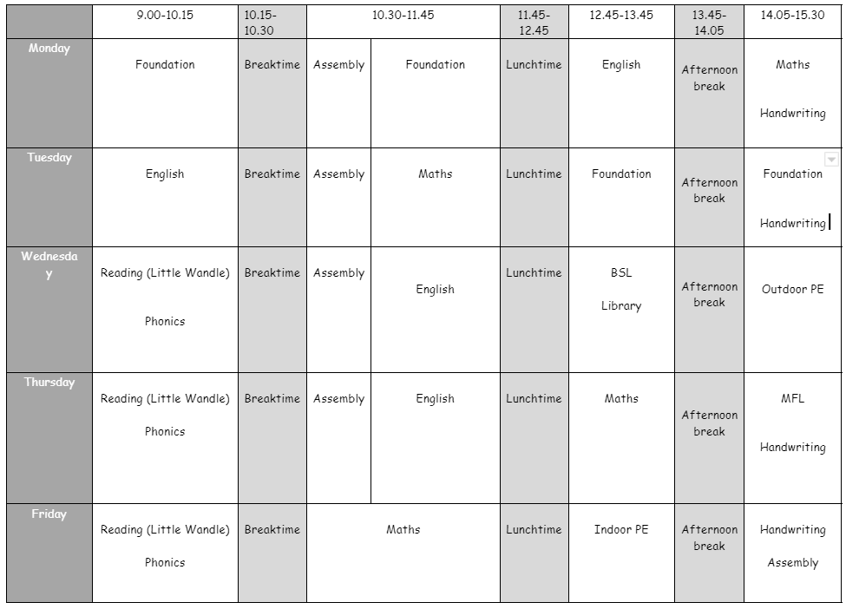
Timetable
Although this is our timetable, things may sometimes change.
P.E. days: Wednesdays and Fridays.
Please send PE kits in on a Monday and we will send home on a Friday.
PE Kit: White T shirt, shorts/tracksuit bottoms/sweatshirt in school colours
Trainers/black plimsolls
Children must come to school in their school uniform.

Slide 5
Uniform
Footwear:Black flat sensible, safe shoes or ankle high boots with good grip on the sole. Alternatively, smart, black trainers with no white or coloured flashes or patterns. Bright coloured laces are not permitted
High heels, flip flops, open-toed sandals, steel toed shoes/boots and greater than ankle high boots are unsafe & not appropriate for school. Pupils may wear boots to/from school but will need to bring a pair of shoes to change into
It is our school policy that all children wear school uniform when attending school. School uniform is part of the school ethos and in sending their child/ren to James Wolfe Primary School, parents agree to support our policy.
Our uniform consists of:
White polo shirt
Navy blue sweater or cardigan (we promote the wearing of jumpers/polo shirts with logos but plain versions in the school colours are acceptable)
Black or grey trousers, shorts or skirts
Blue checked dress
Plain socks or tights in school colours (white, black, navy blue or grey)
Plain headscarves in school colours
Plain and discreet headbands and hair ties
A peaked cap for summer protection (sunglasses are not permitted)
Jewellery: It is encouraged that pupils do not wear jewellery to school, especially as individuals become very upset if a treasured piece of jewellery goes missing or is damaged. The only acceptable items of jewellery permitted are small studs for pierced ears and sensible watches. Please note that the school will be unable to take any responsibility for any jewellery/watches lost or damaged.
Make up: No make-up is to be worn to school (this includes nail polish)
Please label all school clothes with your child’s name. We do our best to re-unite children with clothes they leave lying around the playground and building.

Slide 6
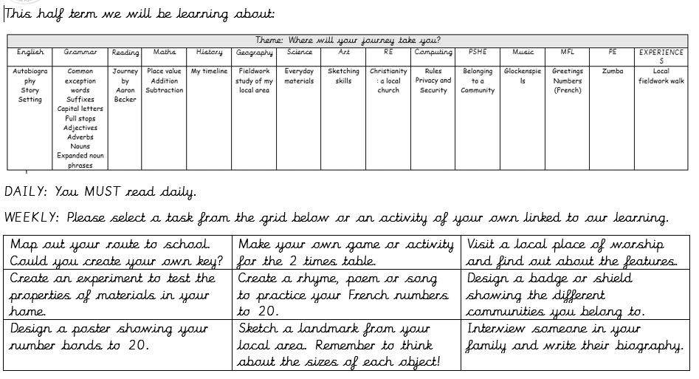
Homework
Homework grids will be sent out half termly throughout the year and uploaded onto Google Classroom.
Children can bring in their homework books throughout the week and books will be returned on Friday. Homework handed in on Google Classroom will be checked regularly.
Please practise 2, 5, 10 times tables with your child.
Please practice high frequency words which can be found on Google Classroom.

Slide 7
Home reading
Children will have received a school reading book.
Please read with your child nightly and record this in their reading records.
Please send in reading books to be changed weekly. These will be changed and returned either the same or the next day.
Ebooks will also be uploaded to Collins Big Cat weekly.
Children will also have access to the school library, where they can bring home a book which can be read for pleasure.

Slide 8
Statutory testing
Year 2
At the end of the year, the teacher will make formal End of Key Stage teacher assessments as directed by the Department for Education in English, maths and science. The assessments are an indicator of how the children are progressing and achieving at the end of Year 2 and are based on all of their learning and hard work throughout the year, not on how a child performs just on one particular day or in one particular test. During this time your children will sit a number of SATs papers to help assess their reading and maths. This is done in an informal way and as part of normal lessons so that pupils do not feel worried about the assessments. You will receive further information on this later in the year.

Slide 9
Special educational needs and or disabilities (SEND)
The SEND coordinator (SENDCo) at James Wolfe Primary School and centre for Deaf children is Carol Minkoulou
If you have any SEND related concerns, please remember that your class teacher is the first point of contact, as they are the people in class with your children each day. Your class teacher will then share these concerns with Ms Minkoulou so appropriate support can be put in place if needed.

Slide 10
Communication
Class teacher is your first point of contact - admin@jameswolfe.greenwich.sch.uk
If you need more help, please contact Miss Brown, Year 2 Lead through the admin email. (Subject: For the attention of Miss Brown)
Weekly Wolfe will be sent out every Thursday. This provides key dates, upcoming events and information.
Trip letters are given out by class teachers. Spare copies can be found at the office.
School website - https://www.jameswolfe.greenwich.sch.uk/

Slide 11
We are very excited about working with your wonderful children!

Slide 12
Any Questions?

